Slide 1


The Third Grade Reading Law: How do we go from law to practice?
Matthew Burns
University of Missouri
@burnsmk1

Slide 2
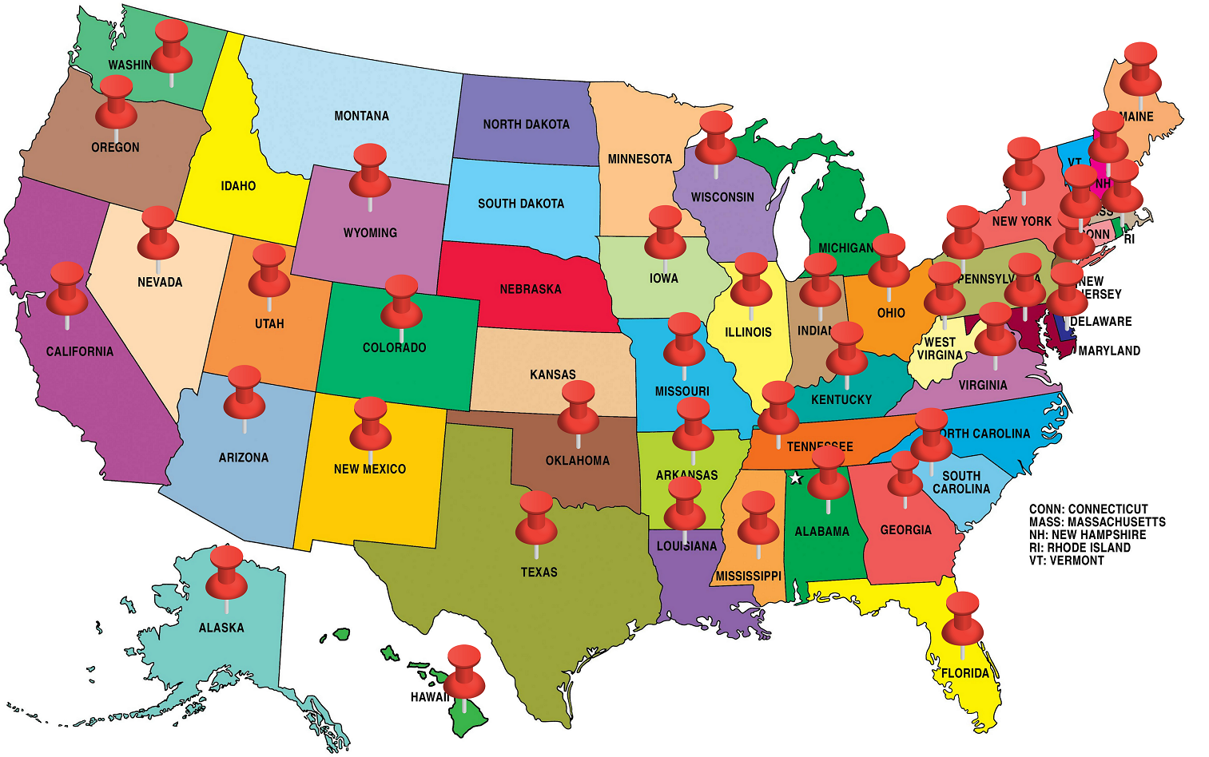
States with a Dyslexia Law

Slide 3
School Psychologists as Researchers
Consumers
Synthesizers
Conductors
(Keith, 2008)

Slide 4
Early Warning Signs - Myths
Preschool
  May talk later than most children
  May have difficulty pronouncing words, i.e., busgetti for spaghetti, mawn lower for lawn mower
  May be unable to recall the right word
  May have trouble interacting with peers
  May be unable to follow multi-step directions or routines
  Fine motor skills may develop more slowly than in other children

Slide 5
Early Warning Signs - Myths
Early Elementary
  Letter reversals – d for b as in, dog for bog
  Word reversals – tip for pit
  Inversions – m and w, u and n
  Transpositions – felt and left
  Substitutions – house and home
  May transpose number sequences and confuse arithmetic signs (+ - x / =)
  May be impulsive and prone to accidents
  May have difficulty planning
  Often uses an awkward pencil grip (fist, thumb hooked over fingers, etc.)
  May have trouble learning to tell time
  May have poor fine motor coordination

Slide 6
Early Warning Signs
May be slow to add new vocabulary words
May have difficulty with rhyming
May have trouble learning the alphabet, numbers, days of the week, colors, shapes, how to spell and write his or her name
May have difficulty telling and/or retelling a story in the correct sequence
Often has difficulty separating sounds in words and blending sounds to make words
Seems to be unable to recognize letters in his/her own name
Has difficulty decoding single words (reading single words in isolation)
May be slow to learn the connection between letters and sounds
A family history of reading and/or spelling difficulties

Slide 7
The Federal Regs.
§300.307 Specific learning disabilities.
the criteria adopted by the State—
(1) May prohibit the use of a severe discrepancy between intellectual ability and achievement for determining whether a child has a specific learning disability as defined in §300.8;
(2) May not require the use of a severe discrepancy between intellectual ability and achievement for determining whether a child has a specific learning disability as defined in §300.8;
(3) Must permit the use of a process that determines if the child responds to scientific, research-based intervention as part of the evaluation procedures described in §300.304; and
4) May permit the use of other alternative research-based procedures for determining whether a child has a specific learning disability as defined in §300.8.

Slide 8
DSM – 5 (APA)
Specific Learning Disorder – Reading, not dyslexia.
Difficulty in at least one of the following areas that has persisted for at least 6 months despite the provision of extra help or targeted instruction – (a) inaccurate and slow reading, (b) understanding meaning of what is read, (c) spelling, (d) written expression (grammar, punctuation or organization), (e) understanding number concepts, facts, or calculation, and (f) mathematical reasoning.
The affected academic skills are substantially and quantifiably below those expected for age and cause impairment in academic, occupational, or everyday activities
Onset during the school-age years, although may not fully manifest until young adulthood in some individuals
Intellectual Disabilities, uncorrected auditory or visual acuity problems, other mental or neurological disorders or adverse conditions (psychosocial adversity, lack of proficiency in the language of instruction, inadequate instruction) must be ruled out before a diagnosis of SLD can be confirmed.

Slide 9
Third Grade Reading Law

Slide 10
What’s Good?
(ii) Periodically screens and monitors the progress of each pupil’s reading skills, at least 3 times per year.
(iii) Provides evidence-based core reading instruction.
(B) Provides intensive development in the 5 major reading components: phonemic awareness, phonics, fluency, vocabulary, and comprehension.
(C) Is systematic, explicit, multisensory, and sequential.
Term “evidence-based” appears 10 time!!!!!!

Slide 11
Assessment
(a) Approve 3 or more valid and reliable screening, formative, and diagnostic reading assessment systems for selection and use by school districts and public school academies in accordance with the following:
(i) Each approved assessment system shall provide a screening assessment, monitoring capabilities for monitoring progress toward a growth target, and a diagnostic assessment.

Slide 12

Four Purposes of Assessment
Program evaluation: How is the education system working for students overall?
    MAP
Screening: Which of my students are not meeting grade level expectations given Universal Instruction?
    E.g., STAR, NWEA
Diagnostic: What are the specific needs of students who struggle?
E.g., measures of specific skills
Monitoring Progress: What does the student’s growth look like?
E.g., CBM (Aimsweb & Dibels)
Notes:
Instruction: F & P
For young kids, screening and instructional design are lots of overlap
Progress monitoring: What does the student’s growth look like given the support s/he is receiving? (I.e., Is the supplemental support/intervention working?)

Slide 13
Approved Initial Assessments (DESE)
Aimsweb
DIBELS
EasyCBM
FastBridge
Degrees of Reading Power
Iowa Assessments
I-Ready
NWEA MAP
STAR
Predictive Assessments of Reading
95 Percent Group’s Phonological Awareness Screener for Intervention
Reading Inventory (Houghton Mifflin Harcourt)
https://www.michigan.gov/documents/mde/17-18_Initial_Assessment_List_560866_7.pdf

Slide 14
Screener | MAP < 25th %ile | MAP > 25th %ile | Total
Oral Reading Fluency (ORF)
ORF < Benchmark Goal | 276 | 145 | 421
 | a | b
ORF > Benchmark Goal | 46 | 501 | 547
 | c | d
Total | 322 | 646 | 968
Informal Reading Inventory (RI)
RI < Benchmark Goal | 90 | 189 | 279
 | a | b
RI > Benchmark Goal | 200 | 367 | 567
 | c | d
Total | 290 | 556 | 846
Sensitivity = a / (a + c)
.86 for CBMF
.31 for F&P
Specificity = d / (b + d)
.78 for ORF
.66 for F&P,
Correct Classification = (a + d) / N
.80 for ORF
.54 for F&P

Slide 15
The Phonological Awareness Screener for Intervention (PASI)
An easy-to-administer informal diagnostic assessment
Information from the PASI eliminates guessing and leads directly to Tier 2 and 3 focused intervention instruction.
The PASI is a valuable tool to place students in proper skill groups:
  Identify mastered and deficit skills in phonological awareness skills
  Exit student from group and regroup for next skills

Slide 16
Screening Process
Screen with PA for kindergarten
Screen with decoding for first grade
Screen with CBM-R for 2nd – 5th
  Low accuracy (93% 1st – 3rd, 95% 4th and 5th) = low decoding
  Assess NWF or WA for kids who score low
Screen with comprehension for MS and HS (use CBM-R or decoding if low)

Slide 17
What About Spelling
Spelling = decoding
Terrible screener
  Kids with low decoding are poor spellers, BUT
  Bunch of kids who are poor spellers who decode fine
Good diagnostic
WTW (already have it then use it)

Slide 18
Step 2 – Consider Classroom
The hallmark of dyslexia is not poor reading performance
It is poor reading performance in the face of effective reading instruction.
Most children who struggle to learn to read do not have dyslexia
Poor reading performance should signal the need for screening.

Slide 19
Procedure
Partner Reading | Paragraph Shrinking
Stronger reader reads aloud for 5 minutes The weaker reader reads aloud the SAME text for 5 minutes | For 5 minutes the stronger read continues reading new text in the story, stopping after each paragraph to summarize For 5 minutes the weaker reader continues with the new text, stopping after each paragraph to summarize
Notes:
Annie

Slide 20
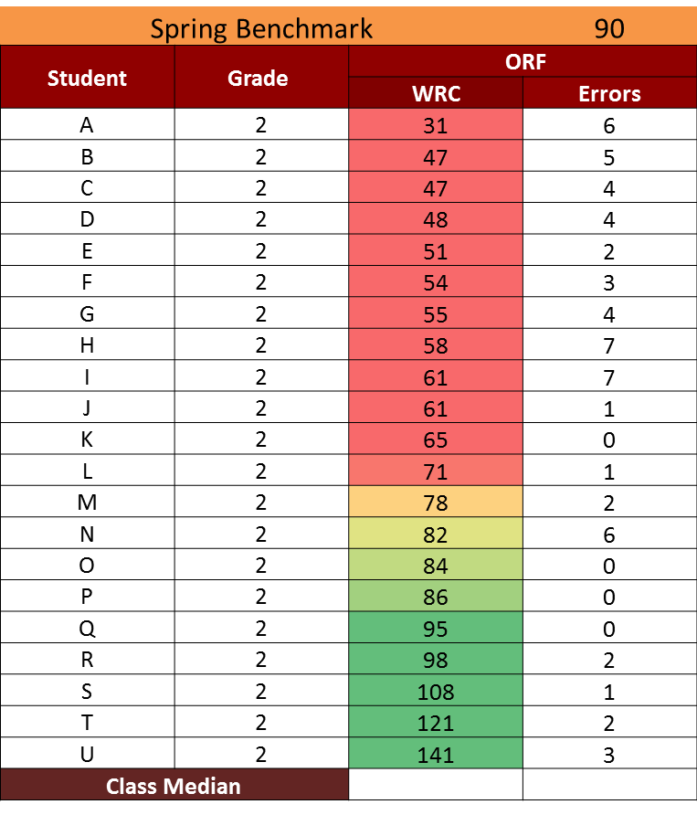


Partner Reading
Partnerships

Slide 21
Timeline
Collect Data: Pre-test (fluency and comprehension)
Day 1: Train Students on Set Up Procedures and Partner Reading, Practice Reading for 10 minutes, Error Correction
Day 2: Train Students on Paragraph Shrinking, Practice Reading for 10 minutes
Day 3-10: Partner Reading, Paragraph Shrinking 15 minutes every day
Collect Data: Post-test (fluency and comprehension)
Notes:
Annie

Slide 22
Partner Reading
First Reader reads for 5 minutes.
Second Reader reads the same text for 5 minutes.
Second Reader retells for 1 minute.
RULES
Talk only to your partner and only talk about Partner Reading
Keep your voice low
Help your partner
Try your best!
Notes:
Maureen

Slide 23
Paragraph Shrinking
Name the most important who or what.
Tell the most important thing about the who or what.
Say the main idea in 10 words or less.
Notes:
Maureen

Slide 24

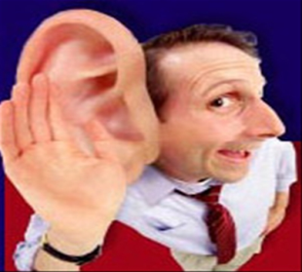


STOP. That word is______________
What word?
______________________
Correction Procedures
Good Job!
Go back and read that line again.
Notes:
Maureen

Slide 25
What we found: 3rd grade Partner Reading data
Third Grade
Third Grade Benchmark | 91 Words Read Correctly (WRC)
 | Pre Intervention Class Median (WRC) | Post Intervention Class Median (WRC) | Slope (WRC)
Class 1 | 81 | 104 | 11.5
Class 2 | 87 | 115 | 14
Notes:
Maureen

Slide 26
What we found: 3rd grade Partner Reading data
 | Students Below Benchmark Pre Intervention | Students Below Benchmark Post Intervention | Total Students in Class
Third Grade Class 1 | 10 | 5 | 20
Third Grade Class 2 | 13 | 5 | 23
Notes:
Maureen

Slide 27
Growth from Winter to Spring Class-Wide Interventions
10 Classrooms K-3
Notes:
Matt
No Second Grade classrooms did a class-wide intervention after Winter Benchmark
One Year of Growth=PRESS Targeted Growth Rate * 16 weeks

Slide 28
Growth from Winter To Spring NO Class-Wide Interventions 11 Classrooms K-3
Notes:
Matt-
The NWF Growth Fall to Winter is from handout you provided on Class-wide Data attached to this email. That handout says “Class-wide average increase=25.32” for First Grade Classrooms with class-wide interventions. Please confirm I selected correct data here. Otherwise, the targeted growth is calculated by taking the targeted growth rates from our PRESS Overview document (listed below) and multiplying by the number of weeks between Fall and Winter Benchmarking which I count to be 16 weeks-though please confirm. The Targeted Growth Rates from PRESS document:
K:.97*16 wks=16 LSF
1st: 1.50*16wks=24 NWF
2nd: 1.50*16 wks=24 ORF
3rd: 1.25 * 16 wks=20 ORF
Growth Fall to Winter facts from spreadsheet except First Grade NWF from Matt’s handout

Slide 29
Class-wide Interventions Implemented in 10 of the 21 Classes Below Winter Benchmark:
9 of the 10 Above Spring Benchmark
Notes:
Matt

Slide 30
NO Class-wide Intervention Implemented in 11 Classes Below Winter Benchmark
2 of the 11 Above Spring Benchmark

Slide 31
Science Project
Approximately 140 4th and 5th graders
Science content
Readworks.org
Grade level ORF and science MAZE
2 weeks

Slide 32
MAZE Growth 4th Grade

Slide 33
MAZE Growth 5th Grade

Slide 34
Control Group
Partner Reading

Slide 35
Control Group
Partner Reading ELL

Slide 36
 | CBM-R Pre | CBM-R Post | MAP-Reading Score
Student 1 | 48 | 92 | 189
Student 2 | 122 | 142 | 194
Student 3 | 126 | 147 | 196
Student 4 | 82 | 113 | 190
Student 5 | 102 | 117 | 188
Student 6 | 77 | 97 | 190
Student 7 | 51 | 70 | 161
Student 8 | 84 | 95 | 192
Student 9 | 80 | 82 | 174
Student 10 | 102 | 127 | 188
Student 11 | 83 | 106 | 189
Student 12 | 38 | 47 | 149
Student 13 | 104 | 115 | 196
Student 14 | 152 | 161 | 211
Student 15 | 143 | 158 | 205
Student 16 | 115 | 125 | 195
Student 17 | 142 | 160 | 224
Student 18 | 114 | 127 | 196
Student 19 | 13 | 40 | 138
Student 20 | 75 | 92 | 185
Student 21 | 141 | 136 | 205
Student 22 | 87 | 105 | 189
Student 23 | 49 | 47 | 145
Median | 87 | 113 | 190
Agreement
Pre CBM-R score and MAP-R score = 69.6%
Post CBM-R score and MAP-R score = 91.3%

Slide 37
Personalized Learning

Slide 38
(b) For any pupil in grades K to 3 who exhibits a reading deficiency at any time, based upon the reading assessment system selected and used under subdivision (a), provide an individual reading improvement plan for the pupil within 30 days after the identification of the reading deficiency.
The individual reading improvement plan shall describe the reading intervention services the pupil will receive to remedy the reading deficiency.
A school district or public school academy shall provide intensive reading intervention for the pupil in accordance with the individual reading improvement plan until the pupil no longer has a reading deficiency.

Slide 39
DESE Website Personalized Learning Models
https://www.michigan.gov/mde/0,4615,7-140-28753_65799-351442--,00.html
Teaching in a Flipped Classroom - This vignette shows different ways to develop lessons outside of class as well as a variety of activities and ways to use the in-class face-to-face time so that each student has his/her needs met.
Engaging Students in Meaningful Learning -
Project Based Learning - An inside look at the daily doings and big picture of Kent Innovation High School, a project-based learning school in Grand Rapids, MI.
Friday Night Lights - In the Classroom - In this webinar, you'll get specific examples of how he creates meaning for his students by giving them real audiences. It works for students in football and theatre and band. Why can't it work in the classroom?
Creating a Genius in Every Hour -

Slide 40
Special Education
President’s Commission on Excellence in Special Education
Reduce paperwork and increase flexibility
Identify and intervene early
  Service first and assessment later
“Those that get counted, count.”
Use special education staff more effectively

Slide 41
Interventions for Children with LD
Reading comprehension 1.13
Direct instruction .84
Psycholinguistic training .39
Modality instruction .15
Diet .12
Perceptual training .08
        Kavale & Forness, 2000

Slide 42
Leveled Literacy Intervention
Effect Sizes
Kindergarten = .26
First Grade = .36
Second Grade = -.09
Ransford-Kaldon, C. R., Flynt, E. S., Ross, C. L., Franceschini, L. A., Zoblotsky, T. A., Huang, Y., & Gallagher, B. (2010). Implementation of effective intervention: An empirical study to evaluate the efficacy of Fountas & Pinnell’s Leveled Literacy Intervention Program (LLI) for 2009-2010. Memphis, TN: The University of Memphis, Center for Research in Educational Policy.

Slide 43
What the Research Says
24 studies of K-8 small-group reading interventions
  Hall and Burns, 2016
  26 effects
Targeted
  13 effects, g = .65
Comprehensive
  13 effects g = .26

Slide 44
National Reading Panel
Is phonemic awareness instruction effective in helping children learn to read?
Reviewed 52 studies of PA instruction.
Three general outcomes were explored
  PA tasks such as phoneme manipulation,
  spelling,
  and reading tasks such as word reading, pseudoword reading, reading comprehension, oral text reading, reading speed, time to reach a criterion of learning, and miscues
Notes:
Matt

Slide 45
National Reading Panel Results
PA instruction demonstrated better efficacy over alternative instruction models or no instruction
Improved PA measures (strong), reading (d = .53) and spelling skills
Teaching one or two PA skills was preferable to teaching three or more
PA instruction benefited reading comprehension (Ehri et al.).
Notes:
Matt

Slide 46
Means and Ranges of Effect Sizes by Reading Outcome Measure
 | N | Mean ES | SD | Minimum | Maximum
Pseudowords | 24 | .84 | .80 | -.19 | 3.60
Words in Isolation | 48 | .92 | .89 | -.05 | 4.33
Contextual Reading | 24 | .37 | .38 | -.37 | 1.18
Notes:
Matt

Slide 47
Assess 4 NRP Areas
Phonemic Awareness
  Phoneme segmentation fluency (QPA, PAST, CTOPP)
Phonics
  Nonsense word fluency (WJ Pseudoword)
Fluency
  CBM-R (TOSCRF)
Vocabulary/Comprehension
  Measures of Academic Progress or STAR Reading

Slide 48


PRESS
http://www.cehd.umn.edu/reading/PRESS/default.html

Slide 49
Category of Problem MN HS
9-12 with approximately 1600 students
69.2% pass reading
9th-10th grade
28% low on MAP (~225)
45% Low on TOSCRF (~100)
  64% low on phonics (~65)
  36% acceptable phonics (~36)

Slide 50
Groups
Randomly assigned to two groups
  Read 180
  Targeted (phonics – REWARDS, fluency – Read Naturally, comprehension – Read 180
Wait list control group
20 minutes each day for 13 weeks in addition to reading and study skills

Slide 51
 | Targeted Interventions |  | Control |  | Waitlist Control
Variable | Mean | SD | Mean | SD | Mean | SD
Fluency Pretest | 90.17 | 7.65 | 89.88 | 9.73 | na | na
Fluency Posttest | 98.33 | 7.27 | 94.32 | 8.77 | na | Na
MAP Fall | 206.00 | 9.25 | 211.00 | 10.11 | 210.37 | 6.56
Map Winter | 217.21 | 7.56 | 212.40 | 8.06 | 212.78 | 6.04
ANCOVA for fluency F (1, 42) = 4.98, p < .05, d = .50
ANCOVA for MAP F (2, 74) = 5.84, p < .05, partial eta squared = .14.

Slide 52
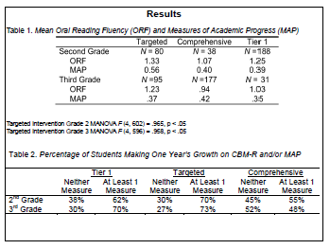

Slide 53
Student | MAP RIT | RIT %ile | ORF | Accuracy
2 | 144 | 1 | 2 | 20%
36 | 146 | 1 | 7 | 41%
33 | 148 | 1 | 11 | 52%
34 | 160 | 6 | 22 | 82%
10 | 158 | 3 | 23 | 77%
27 | 158 | 3 | 27 | 87%
7 | 154 | 1 | 30 | 77%
11 | 160 | 6 | 31 | 82%
6 | 160 | 6 | 36 | 86%
5 | 152 | 1 | 38 | 91%
4 | 169 | 24 | 42 | 91%
32 | 166 | 17 | 44 | 90%
37 | 161 | 8 | 50 | 96%
17 | 174 | 37 | 54 | 95%
9 | 162 | 9 | 57 | 88%
30 | 155 | 1 | 57 | 93%
26 | 166 | 17 | 58 | 92%
3 | 177 | 45 | 68 | 96%
19 | 180 | 53 | 68 | 94%
22 | 190 | 78 | 72 | 99%
13 | 172 | 32 | 74 | 96%
1 | 175 | 39 | 75 | 95%
8 | 187 | 71 | 76 | 96%
14 | 182 | 58 | 78 | 99%
31 | 172 | 32 | 81 | 96%
25 | 176 | 42 | 86 | 99%
38 | 184 | 64 | 97 | 97%
28 | 193 | 84 | 100 | 99%
23 | 191 | 80 | 105 | 98%
18 | 188 | 73 | 110 | 99%
21 | 178 | 47 | 110 | 99%
16 | 186 | 69 | 116 | 99%
35 | 181 | 56 | 140 | 100%

Slide 54
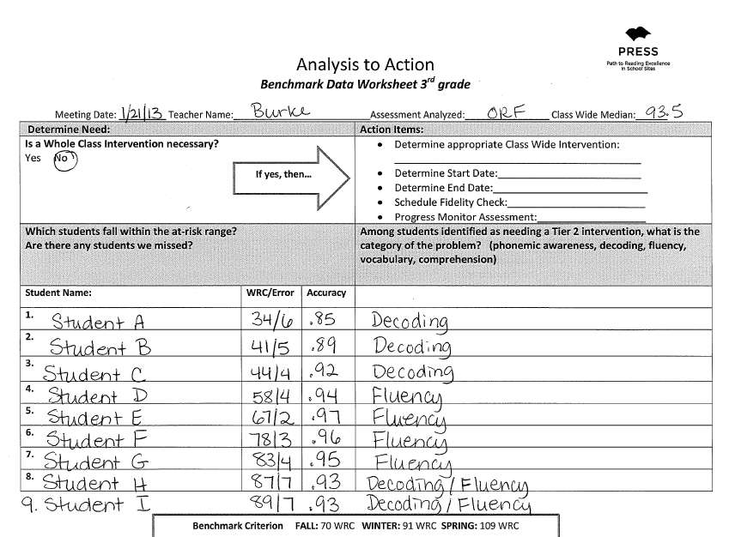
ACCURACY
> 93%
Fluency intervention
Notes:
Annie

Slide 55
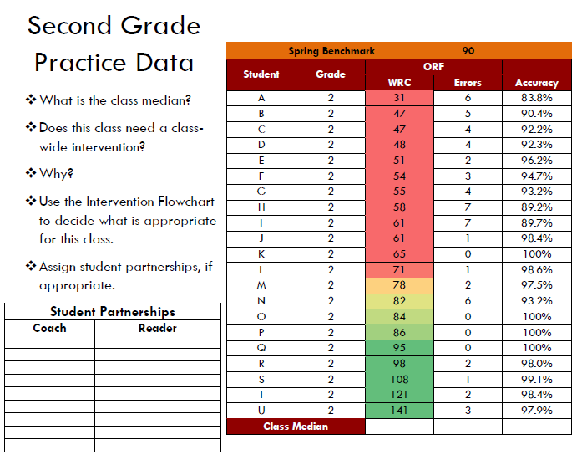

Slide 56
`
Grade | Phonemic Awareness | Phonics | Fluency | Vocabulary | Comprehension
Kindergarten | EIR – K | EIR – K | NA | Text Talk | NA
First Grade | Road to the Code | Road to the Code | NA | Text Talk | NA
Second Grade | Fast Forward Language | Corrective Reading | Six Minute Solution | Building Vocabulary Skills | Comprehension Plus
Third Grade | Fast Forward Language | Corrective Reading | Six Minute Solution | Building Vocabulary Skills | Comprehension Plus
Fourth Grade | NA | REWARDS | Six Minute Solution | Building Vocabulary Skills | Comprehension Plus
Fifth Grade | NA | REWARDS | Six Minute Solution | Building Vocabulary Skills | Comprehension Plus

Slide 57
Websites
www.intensiveintervention.org/chart/instructional-intervention-tools
www.ebi.Missouri.edu
www.gosbr.net
http://www.cehd.umn.edu/reading/PRESS/about.html

Slide 58
The Really Bad News!
(i) That, based on standardized testing, this state has determined that the pupil may be required to be retained in grade 3 as provided under state law
  The pupil may still be allowed to enroll in grade 4 if he or she demonstrates a grade 3 reading level through performance on an alternative standardized reading assessment or through a pupil portfolio.
(ii) That the parent or legal guardian has the right to request a good cause exemption that will allow the pupil to enroll in grade 4 in the next school year.

Slide 59
Research (Hattie, 2009)

Slide 60
Effect on Dropout
National Center for Educational Statistics, 2006

Slide 62
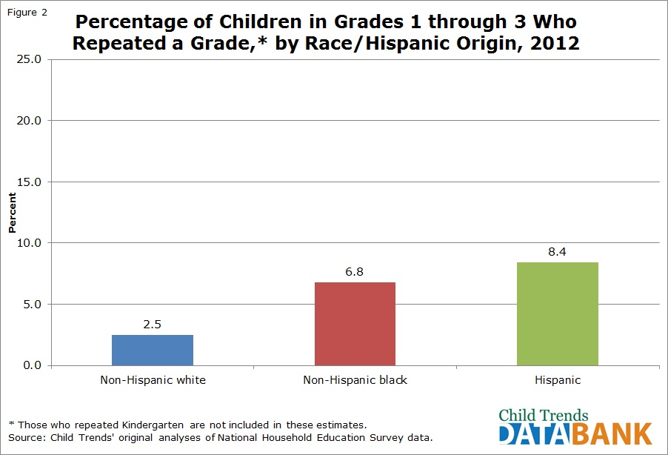

Slide 63
Parents as Partners
Discuss long-term effects
Link with community resources
Show progress monitoring data
Keep well informed

Slide 64
Intensify the Intervention

Slide 65
Merge Neuropsych and RTI (Feifer, 2008)
We should assess cognitive constructs such as verbal IQ, executive functioning, working memory, attention, and reading fluency.
“Specifying the underlying linguistic and cognitive factors associated with poor reading comprehension skills may be helpful toward developing more effective intervention strategies to assist children” (p. 824), especially for those receiving a Tier 3 intervention.

Slide 67
Working Memory
Melby-Lervag & Hulme, 2012
  Verbal Ability .13
    Comprehension and problem solving
    Children (-.05) and young children (.03)
  Word Decoding .13
  Arithmetic .07
“There was no convincing evidence of the generalization of working memory training to other skills.”

Slide 68
Executive Functioning (EF)
Jacob and Parkinson (2015) - 67 Studies
Most of studies occurred in 2010 or later
EF and academic skills are correlated (equal for reading and math)
Changing skills in EF did not lead to increased skills in reading and math
No evidence for causal link between EF and reading or math

Slide 70
Skill-By-Treatment Interaction
Burns, Codding, Boice, & Lukito, 2008
Interventions selected based on student functioning in the specific skill
Systematically identify and manipulate environmental conditions that are directly related to a problem
Isolate target skill deficits

Slide 71
Instructional Hierarchy:
Stages of Learning
 | Acquisition | Proficiency | Generalization | Adaption
Learning Hierarchy Instructional Hierarchy | Slow and inaccurate Modeling Explicit instruction Immediate corrective feedback | Accurate but slow Novel practice opportunities Independent practice Timings Immediate feedback | Can apply to novel setting Discrimination training Differentiation training | Can use information to solve problems Problem solving Simulations
Haring, N. G., & Eaton, M. D. (1978). Systematic instructional procedures: An instructional hierarchy. In N. G. Haring, T. C. Lovitt, M. D. Eaton, & C. L. Hansen (Eds.) The fourth R: Research in the classroom (pp. 23-40). Columbus, OH: Charles E. Merrill.

Slide 72
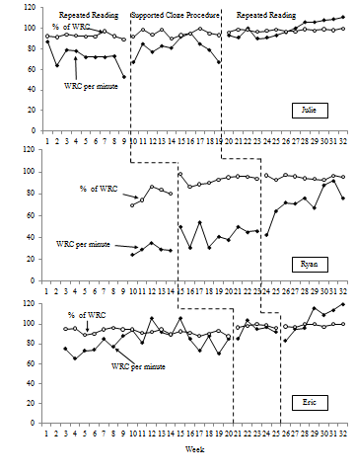
Results

Slide 73
Acquire
Maintain
Generalize
Learning Process
Haven’t had enough help
Haven’t had enough practice
Haven’t had to do it that way before

Slide 74
(ii) Differentiate and intensify professional development for teachers based on data gathered by monitoring teacher progress in improving pupil proficiency rates among their pupils.

Slide 75





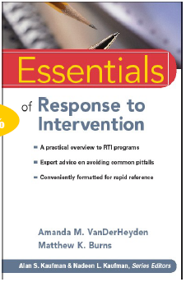



Slide 76

@burnsmk1
burnsmk@missouri.edu

