Slide 1
NASP Updates and Resources
Lisa Kelly-Vance, PhD
NASP President, 2018-19

Slide 2
Did you know NASP is turning 50?
1969-2019

Slide 3
For a half century, we’ve:
Identified barriers to kids’ learning and mental health
Advocated for the policies and practices to overcome those barriers
Established the standards for excellence in school psychology
Advanced (fought for) the distinct professional identity that is school psychology
Created programs and systems to support this work and that of our members
And we’ve done it together.

Slide 4
Because we are ALL NASP!

Slide 5
What does this look like today, with an eye to tomorrow?

Slide 6
Our Strategic Goals
Addressing shortages in school psychology
Expanding implementation of the NASP Practice Model
Advancing school psychologists role as mental and behavioral health provider
Developing leadership skills at the local, state, and national level
Advocating for social justice for all children and youth
Notes:
Addressing shortages in school psychology
Advancing the role of school psychologists
Expanding implementation of the NASP Practice Model
Developing leadership skills at the local, state, and national level
Advocating social justice for all children and youth

Slide 7
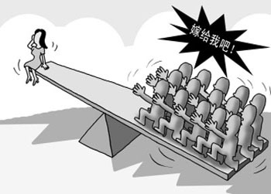
Shortages
Help
Our Mega Issue
Shortages Resource Guide
Ongoing work in 4 critical areas
Self-advocacy resources for graduate education programs
Preventative
responsive
Emergency certification/respecialization guidance documents
Strategies for better use of 2nd chance match programs
State Department of Education advocacy resources regarding the role of school psychologists
Find a Mentor
http://www.nasponline.org/resources-and-publications/resources/school-psychology/shortages-in-school-psychology-resource-guide

Slide 8
NASP Practice Model
Defines the scope of our skills and services
Provides a framework for moving forward
Highly effective advocacy tool at local, state, and federal levels
Implementation Guide offers:
Realistic guidance and action steps
Practical strategies for practitioners
Helpful resources and adaptable tools
Discussion and staff development questions
www.nasponline.org/standards/practice-model/

Slide 9
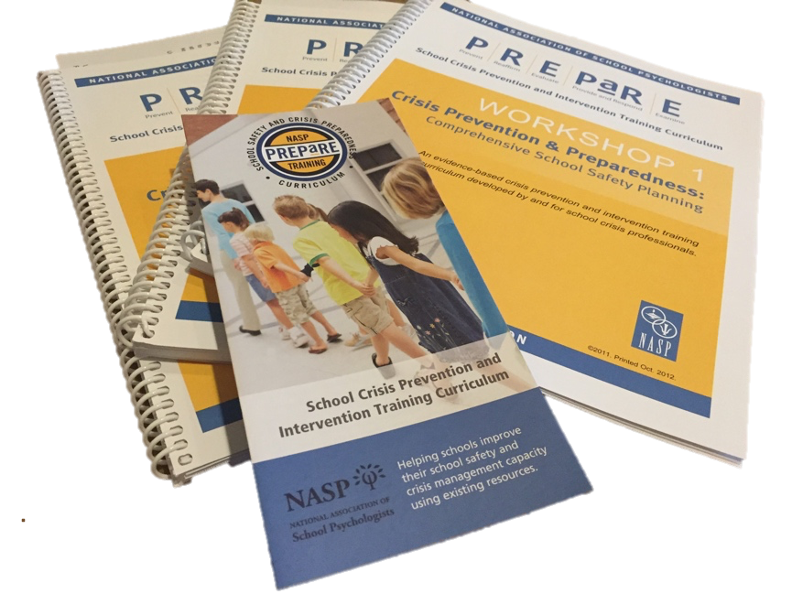
Mental and Behavioral Health Providers
School safety and crisis has highlighted our M/BH skills
Framework for Safe and Successful Schools shifting focus to comprehensive MH and safety
New implementation resources (2018)
Embedded in ESSA
www.nasponline.org/schoolsafetyframework
PREPaRE is building local capacity
Comprehensive school safety and crisis training
Follow #NASPprepared
www.nasponline.org/prepare
Growing attention on trauma informed schools

Slide 10
Leadership Development
NASP Leadership in Action Spotlight
Carving Pathways to Leadership: An Introduction to the NASP Leadership Development Committee (LDC)
Mentoring Toolkit
New Mentor Training Presentation
Building state association capacity

Slide 11
Social Justice and Diversity
A social justice definition for school psychologists was adopted in February 2017 and a Social Justice Committee was formed in 2018
Resources to help schools and families engage in constructive dialogue and action regarding issues of poverty, race, privilege, violence, and economic isolation that affect children’s learning and well-being.
Articles and blog posts
Lesson Plans
Discussion Starters
Resources to help schools and families engage in constructive dialogue about the issues of race, privilege, prejudice, and power.
www.nasponline.org/social-justice
Notes:
Understanding Race and Privilege
Talking About Race and Privilege: Lesson Plans for Middle and High School Students
Viewpoint: Seeing Privilege in a Different Light
"Social justice is both a process and a goal that requires action. School psychologists work to ensure the protection of the educational rights, opportunities, and well-being of all children, especially those whose voices have been muted, identities obscured, or needs ignored.
Social justice requires promoting non-discriminatory practices and the empowerment of families and communities. School psychologists enact social justice through culturally-responsive professional practice and advocacy to create schools, communities, and systems that ensure equity and fairness for all children."

Slide 12
Standards Revisions - 2020
Principles for Professional Ethics
Standards for Graduate Preparation of School Psychologists
Standards for the Credentialing of School Psychologists
Model for Comprehensive and Integrated School Psychological Services (NASP Practice Model)
Notes:
Started the process in 2016, completed June 2020. Will be our standards for 10 years.
Discuss process and LA involvement.
Public Comment period

Slide 13
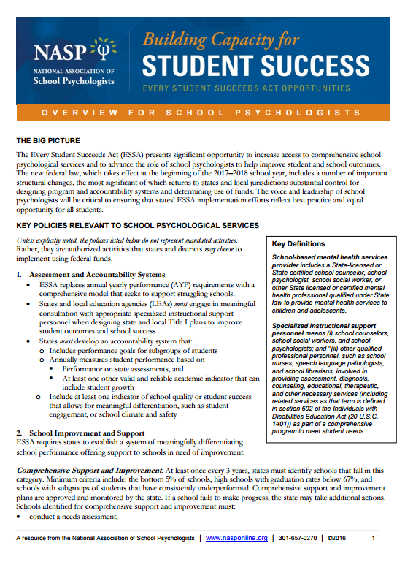
Our Advocacy Voice
Responding to current events
Developing useful member resources
Engaging policymakers on key issues
Building state association capacity
www.nasponline.org/research-and-policy/advocacy-tools-and-resources
Notes:
NASP Adopts Resolution Affirming Commitment to High-Quality Public Education for All Children and Youth
NASP Guidance for Reinforcing Safe, Supportive and Positive School Environments for All Students
NASP Applauds Report Calling for Increased Access to School Psychologists
"13 Reasons Why" Netflix Series: Considerations for Educators
Using Title IV funds for gun purchase

Slide 14
NASP’s Advocacy Voice
Responding to current events
www.nasponline.org/media-room
Notes:
NASP Adopts Resolution Affirming Commitment to High-Quality Public Education for All Children and Youth
NASP Guidance for Reinforcing Safe, Supportive and Positive School Environments for All Students
NASP Applauds Report Calling for Increased Access to School Psychologists
"13 Reasons Why" Netflix Series: Considerations for Educators

Slide 15
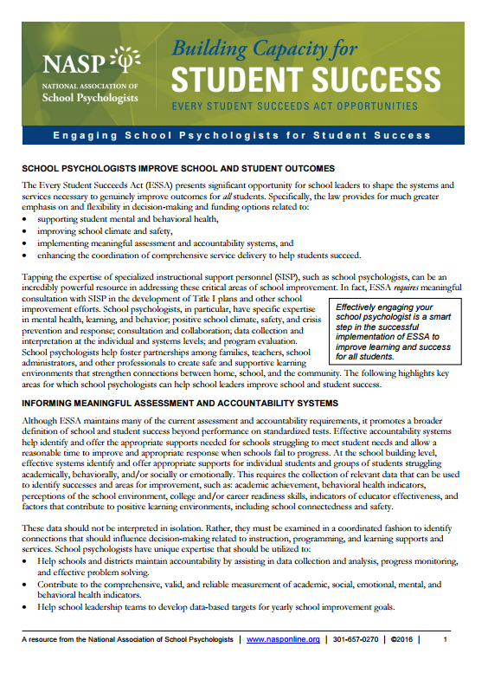
NASP Advocacy Voice
Developing useful member resources
https://www.nasponline.org/research-and-policy

Slide 16
Your Advocacy Matters
"Arming teachers places an unreasonable burden on America's educators," said Tricia Daniel, who represented the Alabama Association of School Psychologists. She urged the [federal safety] commission to instead provide funding for school counselors, psychologists and other mental health professionals.—Education Week (8-28-18)
Michelle Malvey, Colorado
Ben Fernandez, Virginia

Slide 17
Together, we’re raising awareness
“The National Association of School Psychologists recommends a ratio of one school psychologist for every 700 students; however, the average ratio in North Carolina is almost triple this, with our ratio of 1:2,088.”—[NASP member] Amber Gibson, Hickory Record letter-to-the-editor (6-21-18)
“The district intends to be one of the first in Utah to have a full-time psychologist in each of its 36 elementary schools…. We can do so much more now in terms of prevention instead of just intervention,” said [NASP member] Fulvia Franco, who oversees guidance programs for Jordan School District.”—Salt Lake Tribune (7-23-18)
“…schools also need far more psychologists and social workers than they currently have. Hiring more of these professionals is the key to helping students who are on a path to violence before they bring a gun to school.”—New York Times editorial (8-31-18)
Notes:
This kind of press coverage is unprecedented and has been growing over the past year.

Slide 18
Use Our Infographics
View, download, and share our infographics series through social media to introduce key issues to stakeholders and advocate for the work of school psychologists.
www.nasponline.org/infographics
Notes:
Press

Slide 19
School Psychology Awareness Week
November 12–16, 2018
Theme: “Unlock Potential. Find Your Password.”
Adaptable resources and activities to do with staff and students
First ever Virtual Hill Day across the country, Wed. Nov. 14
Possibilities in Action Partners colleague recognition program
Student POWER Award recognition program
www.nasponline.org/spaw
Notes:
School Psychology Awareness Week is a fun way to raise your visibility while reinforcing key wellness and skills-building concepts for students.
With a focus on helping students and colleagues thrive, we developed posters, certificates, recognition activities, and other resources, including the “Possibilities in Action” Partners Program to honor teachers, administrators, parents and others and the “Student POWER Award” to recognize children and youth. We are also adding a new activity for our Gratitude Works program that will align with the thrive theme.

Slide 20
Unlocking NASP’s Potential in Early Childhood
Enhance role and perception of school psychologists in early childhood
Provide resources for school psychologists working in early childhood.
Make connections with other groups
Zero to Three
Head Start
More!

Slide 21
Participate in more than 1,200 peer-reviewed sessions.
Network with thousands of school psychologists from throughout the country.
Visit the exhibit hall to collect free resources and see the latest happenings in the profession.
Expand your own professional and leadership skills.
Registration opens in October!
www.nasponline.org/conventions

Slide 22
Keynote: Mr. Michael Bonner
“I wish I could go back to second grade, so Mr. Bonner could be my teacher."—Ellen DeGeneres
Author of Get Up or Give Up: How I Almost Gave Up on Teaching

Slide 23
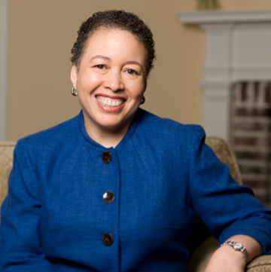
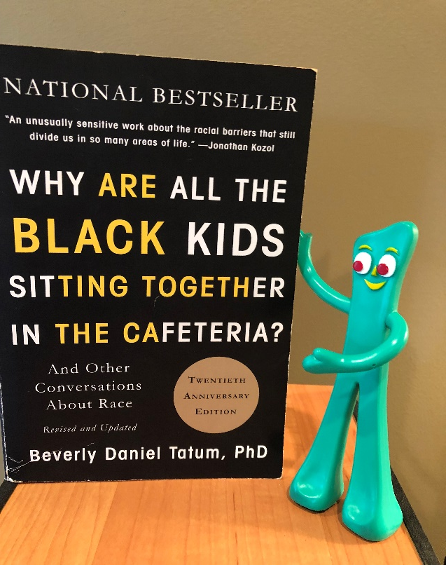
Featured Speaker
Dr. Beverly Daniel Tatum

Slide 24
More Featured Speakers
Dr. Susan Sheridan
Dr. Janine Jones (Distinguished Lecturer)
Dr. Ferial Pearson
Dr. James Ysseldyke et al.
Dr. Iheoma Iruka
Dr. Walter Gilliam

Slide 25
Connect With Colleagues
Join or start a discussion
Share documents, videos, links
Read and post blogs
NASP Communities in Action:
In the 2016–2017 membership year, over 6,000 discussions took place, from 41 different online NASP Communities.
Notes:
The Online Communities are a great place to connect with fellow school psychologists
NASP Member Exchange
Communique, SPR and SPF communities
27 interest group communities
NASP leader working communities
You can share documents, videos and links; join discussion; read and post blogs
We are also on Facebook, Twitter, Pinterest, Linked In, and Instagram. Being part of NASP’s social media is a great way to connect with other school psychologists and get useful information in fun, casual environments.

Slide 26
Connect on Social Media
Learn how to create a Twitter account with our step-by-step e-hows
Discover the main actions of each communication medium
Acquire tips on how to craft your messages
@nasponline
#NASPadvocates
www.nasponline.org/socialmedia
Notes:
Share the venues to follow NASP, and highlight the new member-only resource and how it will be helpful: www.nasponline.org/socialmedia

Slide 27
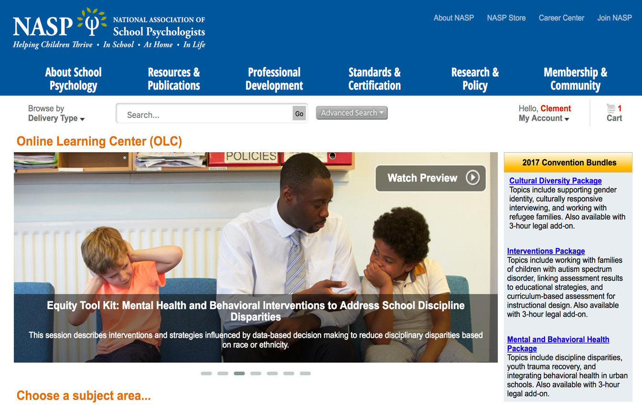
NASP Online Learning Center
Documented CPD
149 webinars and workshops
Ability start, stop, and review content
Live and archived webinars, and recorded premier content from NASP conventions
https://nasp.inreachce.com/

