Slide 1
Blame-Free Implementation Fidelity: Fixing the Weak Link in MTSS
Kim Gibbons, Ph.D.
kgibbons@umn.edu
Michigan School Psychology Association
November 8th, 2019

Slide 2
My Assumptions about This Session
Emphasis on Adult Behaviors - Implementation
Motivation is Self-Induced
Just 90 minutes (12:30 – 2:00)
Just a Sample of Deeper Content !

Slide 3
What Actions Could You Take ?
Following this Session You Could:
Self-Assess Your Strengths in Implementing Interventions with Fidelity
Plan a Protocol to Improve Installation of an Intervention.

Slide 4
Opening Activity
Introduce yourself to two people near you and tell them one question you want answered during this session and one thing you already know about the topic.

Slide 5
Facts about the St. Croix River Education District (SCRED)
National Recognition
Gary Germann
Pilot Site for CBM’s (1980’s)
Early Implementation of RtI (1995)
SLD Eligibility Using RtI (2005)
MN RtI Center (2007-09)
Long History of Data-Based Decision–Making

Slide 7
Back to Alan

Slide 8
Thoughts on Sustainability
It’s hard to sustain practices over time with fidelity.
MTSS is like a recipe. It’s not a McDonald’s ”value menu” where you like one part but not another part.
It takes time to understand it’s a system and it all interacts with each other.
You can’t pick and choose!

Slide 9
7 Steps to Intervention Fidelity
Sustained
Where I Plan to Take You Today !
7
6
5
4
Success
3
2
1
Coulter & Gibbons, 2017

Slide 10
3 Steps 1. Expand Your Working Conception of Fidelity 2. Carefully Design the Dosage 3. Assess Yourself to Expand Your Expertise

Slide 11
Big Ideas: Key Factors in Fidelity
7 Pieces Implies Fidelity is Complex
Collaborative Culture is Essential
Not Evaluation of Implementer.
Helps Everyone (Trainer to Teacher or Interventionist to Student) to Improve
Never a Punitive Exercise

Slide 12
Remember: 3 Types of Available Data
Effect Data
Cause Data
Non-Actionable Data
Kids
Adults
State Test Scores,
Benchmark Tests, Screening,
Progress Monitoring, etc.
Teaching,
Curriculum,
Fidelity, Parental Involvement,
Leadership, Etc.
Free, Reduced Lunch
Gender, Race/Ethnicity, Employment, Crime, etc.
Notes:
“In the context of schools, the essence of holistic accountability is that we must consider not only the effect variable—test scores—but also the cause variables—the indicators in teaching, curriculum, parental involvement, leadership decisions, and a host of other factors that influence student achievement.”
(D. Reeves, Accountability for Learning, 2004)

Slide 13
Why Measure Adult Implementation ?

Slide 14
Why Can Implementation be So Low?
Speculate and Give Us Some Hypotheses

Slide 15
It’s Just Too Easy to Blame Someone Else When an Intervention is Not Implemented with Fidelity

Slide 16
Premise 1 Remember: 2 Types of Critical Data
Effect Data
Cause Data
Kids
Adults
Teaching,
Curriculum,
Parental Involvement,
Leadership,
Etc.
State Test Scores
Benchmark Tests
Progress Monitoring
Here’s Kim
Notes:
“In the context of schools, the essence of holistic accountability is that we must consider not only the effect variable—test scores—but also the cause variables—the indicators in teaching, curriculum, parental involvement, leadership decisions, and a host of other factors that influence student achievement.”
(D. Reeves, Accountability for Learning, 2004)

Slide 17
Think/Pair/Share
What’s Your Practical Definition of Implementation Fidelity ?
Pick a number between 1-5
# Shout Outs
Notes:
Kim comes in here

Slide 18
Premise 3 - Interchangeable Terms:
Integrity
Fidelity
Procedural Reliability
Definition:
“a system of interrelated components, inc. adherence, participant responsiveness, quality of delivery,” ... Leading to Implementation as Intended by the Supporting Evidence
(Edmunds et al., 2016)

Slide 19
Key #1 Expand Your Working Conception of Fidelity

Slide 20
7 Steps to Intervention Fidelity
Need Well-Defined: Specificity Operationalized
Need
Coulter & Gibbons, 2017

Slide 21
Solutionitis
JUMP
Solutionitis
Quickly on a solution before understanding the problem.
Research Base.
Ideas move quickly
Lack
Popular
Ideas become the new hammer.
Hot

Slide 22
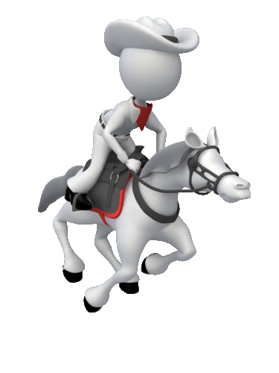
Need Well-Defined
Student Need Operationalized
Actionable Definition
Can be Linked to Evidence-Based Interventions
Back to Alan
“A Problem Well-Put, is Half-Solved.” John Dewey
Coulter & Gibbons, 2017

Slide 23
Need Well-Defined?
Only 45% of first graders have met the fall literacy benchmarks. It is expected that 80% of students will reach benchmarks.
Because they have not yet mastered letter sound correspondence and blending sounds to make words.
Intervention – PALS classwide, Phonics program small group

Slide 24
7 Steps to Intervention Fidelity
Evidence-Based & Linked to Need
Inter-vention
Need
Coulter & Gibbons, 2017

Slide 25
Program Specificity
Note: Fidelity Hard to Measure if the Intervention is Not Well-Defined!
Intervention Meets Criteria for Evidence-Based
Current Intervention Inventory?
Coulter & Gibbons, 2017
Notes:
Activity 4.2 (Stages): “Exploring” with the Initiative Inventory
Resource Type: Activities
Tags: Stages, Module 4: Stages
Author: SISEP
Date: November, 2017
Before starting “something new,” it’s important to review what already exists and how your state, region or district is using existing resources. This Exploration Stage activity can help delineate how much is already being asked of staff, and determine if the “new” will fit with the “existing.” The NIRN Initiative Inventory Process Tool is available to assist teams with developing a plan for completing the NIRN Initiative Inventory.
Resource File(s): NIRN Initiative Inventory.docx
NIRN Initiative Inventory Process Tool.docx

Slide 26
National Center on Intensive Intervention

Slide 27
Evidence-Based Practice/ Intervention
What is an E-B Practice/Intervention? Really ?

Slide 28
“Evidence Based” & ESSA
Appears 58 times in ESSA
Governs Use of Funds & Selection of Interventions
Note: Variation in How Levels of Evidence are Applied & When States & Districts Elect to Use Specific Funds to Support an Intervention or Strategy
Notes:
ESSA Provisions are a Key Element of ESSA
ESSA was mostly designed to fix NCLB, but the law also shifts significant authority back to sates and districts in how they design their education systems, including:
High expectations for all students
Transparent reporting of robust data
Use of evidence, evaluation and continuous improvement
50+ evidence provisions in the law

Slide 29
What is an Evidence-Based Practice ?
Evaluating Progress & Adjusting
Implementing E-B P in Context
Selecting Evidence-Based Practice
Actionable
Problem
Coulter & Gibbons, 2017

Slide 30
Think/Pair/Share
What’s a Practical Definition of Evidence-Based Practice?

Slide 31
Put Simply
What Works ?
For Whom ? &
Under What Set of Conditions ?
So, What is Evidence-Based (in Law) ?

Slide 32
Unpacking Definition of “Evidenced-Based” in ESSA
Strong
At Least 1 Well Designed & Well Implemented Experimental Study (i.e., Randomized).
Moderate
At Least 1 Well Designed & Well Implemented Quasi-Experimental Study (i.e., Matched).
Promising
At Least 1 Well Designed & Well Implemented Correlational Study With Statistical Controls for Selection Bias.
But That’s Just the 1st Decision
Notes:
ESSA's definition of "evidence-based" includes 4 levels of evidence. Together, they create a structure of increasingly strong evidence.
The top 3 levels require findings of a statistically significant effect on improving student outcomes or other relevant outcomes.
The 4th level of evidence in the definition is designed for ideas that do not yet have an evidence base qualifying for the top 3 levels.
Issues to consider:
ESSA does not itself clarify the meaning of all the terms in its definition of "evidence-based" (e.g., "well-implemented" or "correlational").
States and districts may consider other aspects of evidence beyond what is in the definition (e.g., effect size considering sample size and type of study).
ESSA does not itself clarify the meaning of all the terms in its definition of "evidence-based" (e.g., "high-quality research," "is likely to," or "ongoing efforts to examine the effects.

Slide 33
Find the Overlap
Best Available Research Evidence
Classroom & Organizational Context
Decision to Select
Student Characteristics, Geography, Values, Preferences
Resources, inc. Practitioner Expertise

Slide 34
Kim’s Top 5
14+ Sources of Evidence-Based Practices

Slide 35
#1
“To address the challenges posed by the existence of multiple clearinghouses, the Results First Clearinghouse Database has compiled information from eight clearinghouses in one place, reconciled the different systems and vocabularies, and provided the data in a clear, accessible format.”

Slide 36
#2
https://www.evidenceforessa.org/

Slide 37
#5
Notes:
http://www.interventioncentral.org/

Slide 38
#6
Notes:
http://ebi.missouri.edu/

Slide 39
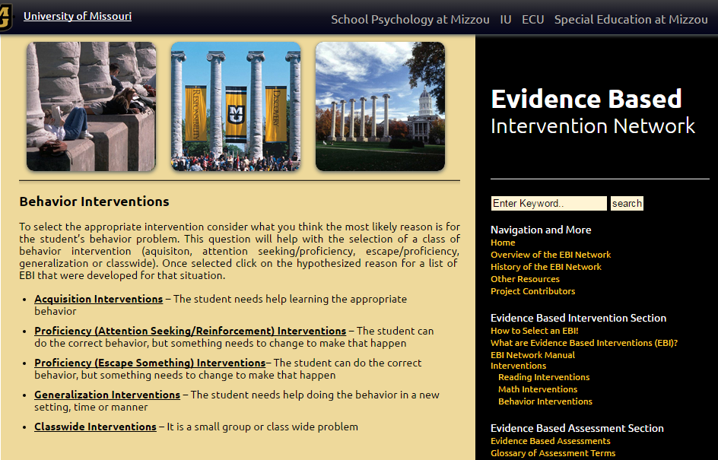
http://ebi.missouri.edu/?page_id=227
Notes:
http://ebi.missouri.edu/?page_id=227

Slide 40
#7

Slide 41
Academic Interventions Tools Chart
Study Quality, ratings from NCII TRC
Study Results, Info on results studies.
Intensity, info on implementation as an intensive intervention.
Additional Research, info on other studies & reviews

Slide 42
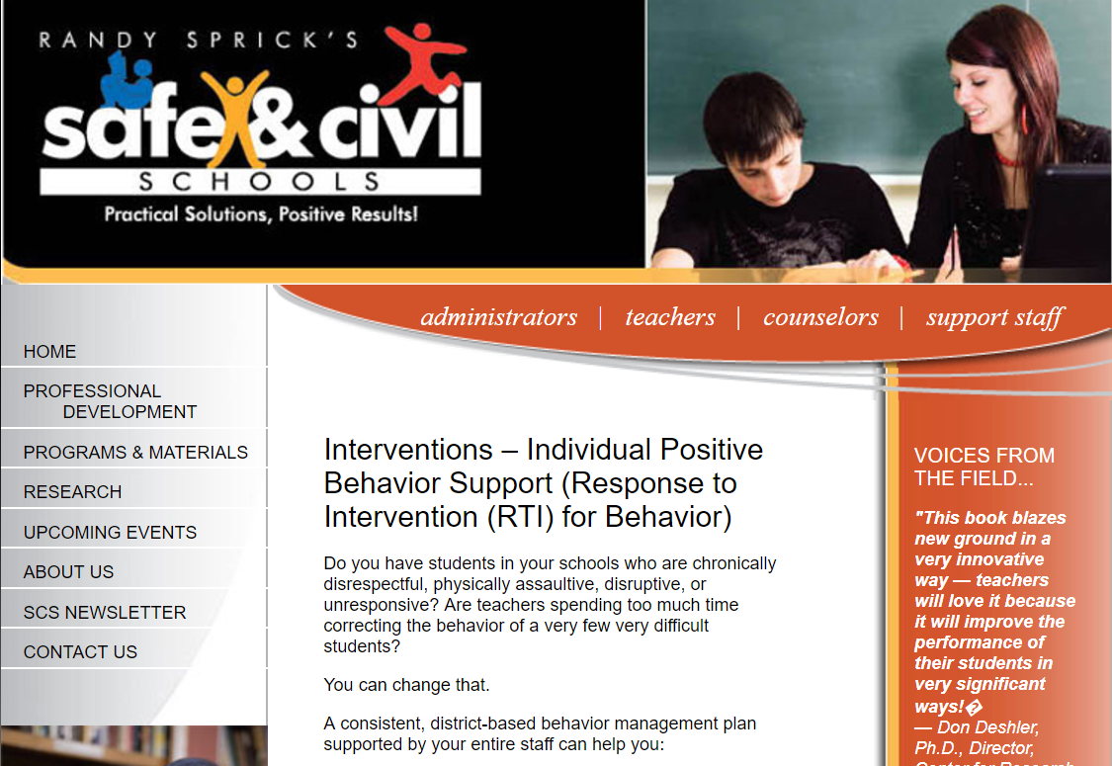
http://www.safeandcivilschools.com/services/individual_ student.php
#8

Slide 43
https://psychcentral.com/
#9

Slide 44
#10
https://www.ncbi.nlm.nih.gov/
Research Database on Interventions

Slide 45
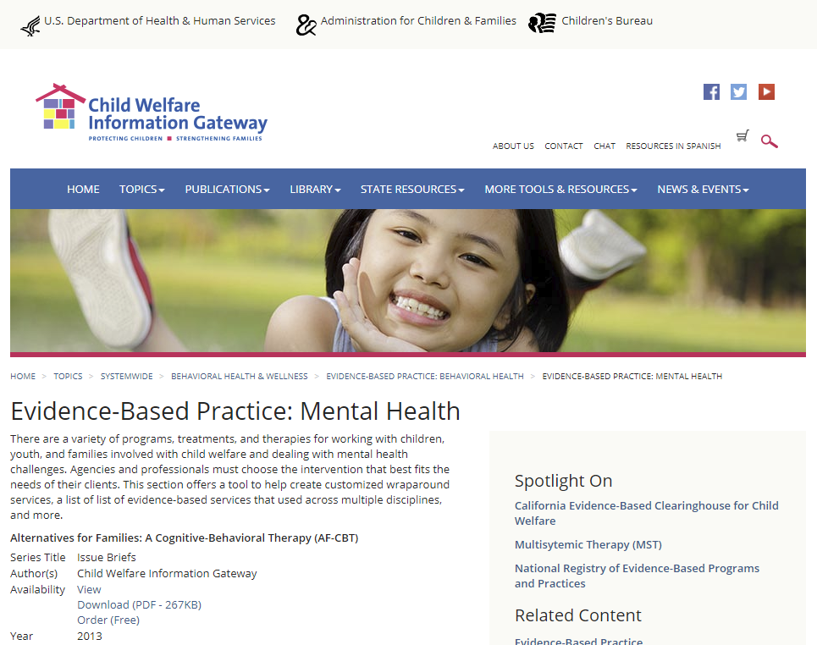
https://www.childwelfare.gov/topics/systemwide/bhw/ebp/mh/
#11

Slide 46
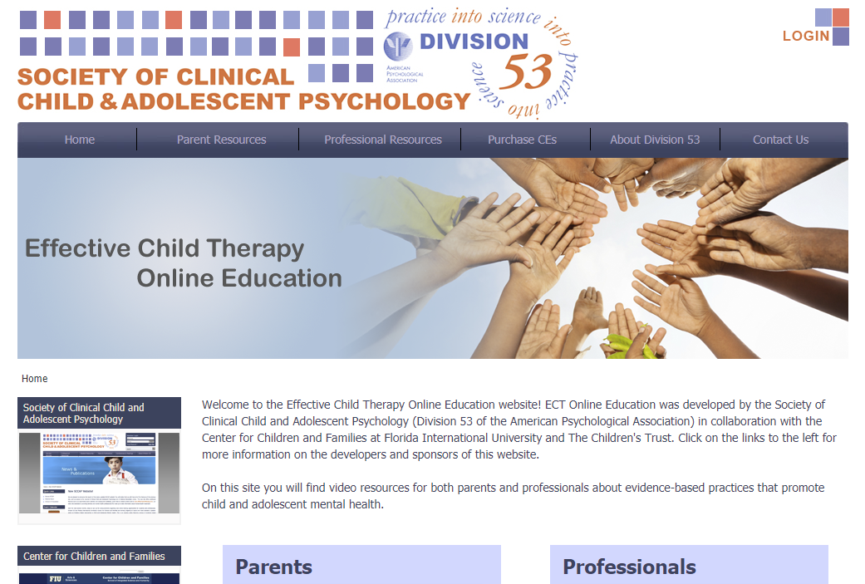
#12
http://effectivechildtherapy.fiu.edu/

Slide 47
https://healthysafechildren.org/topics/evidence-based-interventions
#13

Slide 48
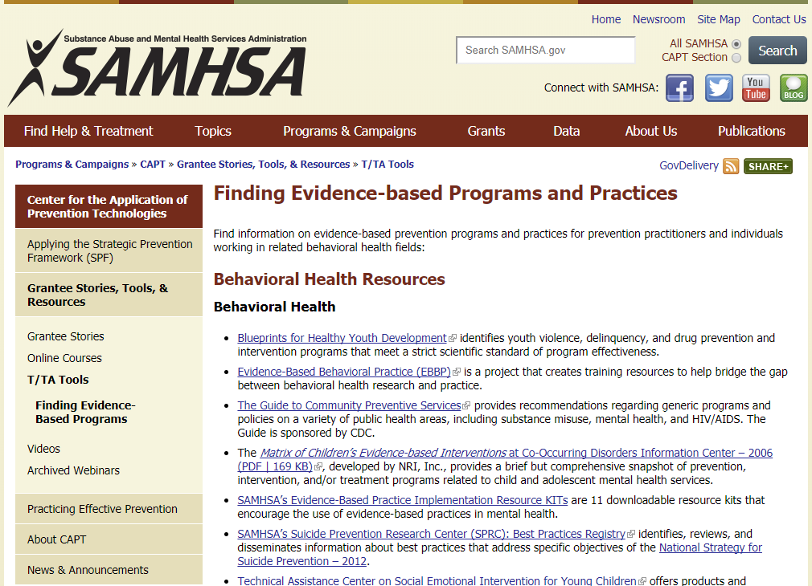
#14
https://www.samhsa.gov/capt/tools-learning-resources/finding-evidence-based-programs

Slide 49
#15
https://store.samhsa.gov/shin/content/SMA11-4634CD-DVD/EBPsPromisingPractices-IDBD.pdf

Slide 50
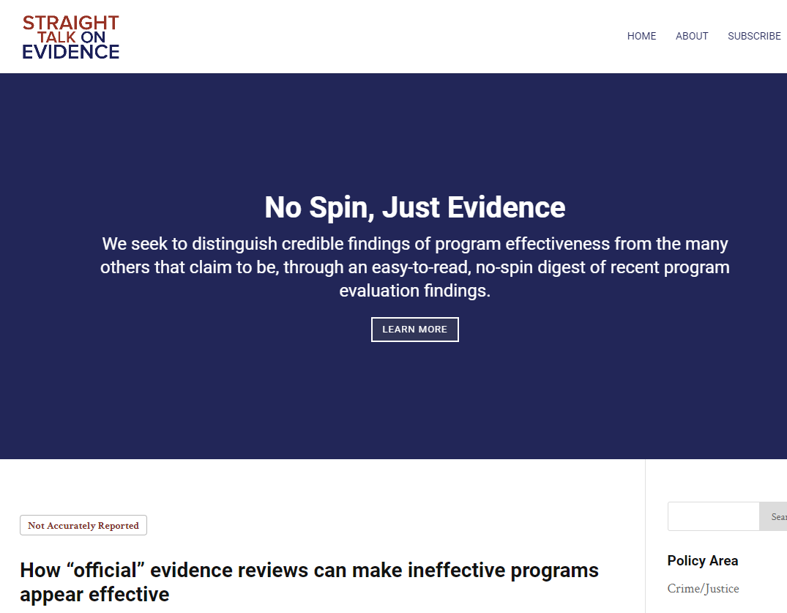
#16
Others You Use ?

Slide 51
http://www.straighttalkonevidence.org/category/k-12-education/

Slide 52
General Resource on ESSA
http://www.air.org/page/essa-co-pilot

Slide 53
Activity
Stand up and tell the person next to you two important things you have learned so far!

Slide 54
Too Many Interventions ? What’s Your Capacity to Implement ?
Careful !
Here’s Kim

Slide 55
7 Steps to Intervention Fidelity
Interventionist Engaged: Acceptable & Committed
Interventionist Engaged: Acceptable & Committed
Engag-ed
Inter-vention
Need
Coulter & Gibbons, 2017

Slide 56
Interventionist Engagement
Interventionist Engagement
Acceptable/Feasible to Interventionist
Easy to implement
Positive
Perceived Effectiveness
Compatible with Instructional Environment
Try IAM (Implementation Acceptability Measure) or IRP (Intervention Rating Profile)
Acceptability
Appropriateness
Feasibility
Coulter & Gibbons, 2017

Slide 57
Test Drive to Reduce Resistance
Teachers who were Resistant to Implementing New strategies
Implemented w/ Higher Rates of Fidelity when
Able to “Test Drive” Several Strategies & Select One Found Most Acceptable.
Higher Levels of Implementation Fidelity Associated w/Increased Student Engaged Time.
Dart et al., 2012
Notes:
Dart et al., 2012, Test driving interventions to increase treatment integrity and student outcomes

Slide 58
Check Out This Valuable Resource for E-B Practices in Interventionist Engagement

Slide 59
Think/Pair/Share
How Do You Attend to Interventionist Engagement?
How Do You Deal with Resistance from the Interventionist?

Slide 60
7 Steps to Intervention Fidelity
Training & Support: At Criterion w/Follow-Up
Skill- ed
Engag-ed
Inter-vention
Need
Coulter & Gibbons, 2017

Slide 61
It is Not Uncommon for Educators to Receive a Single Training on a Policy or Practice & then be Expected to Implement on Their Own.
Change the Color of any element individually!
Color any of the paper or any item to fit your company colors or personal preference. Left click a few times to select the section of the graphic to change color. NOTE: There are segments and pieces to each piece of clipart. Once selected, RIGHT click on the section of the graphic and choose format shape. From there choose a new fill color or if its a gradient, to change the color of that. Good luck ☺

Slide 62
Adult Learning Leading to Knowledge & Skill Acquisition
Post & Trivette, 2010
Notes:
Applying Principles of Adult Learning to Presentations and Trainings
Helen W. Post, Executive Director, Utah Parent Center
Carol Trivette, Ph.D., Center for Early Literacy Learning (CELL), NC - Parent Strand
2010 OSEP Leadership Conference
Point to chart as you say the quote:
I hear and I forget,
I see and I remember.
I do and I understand.
Chinese Proverb

Slide 63
Impact of Training Components on Teacher Learning and Use
Training Component | Concept Understanding | Skill Attainment (Mechanical Use) | Application
Presentation of Theory
Modeling by Trainer
Practice & Low-Risk Feedback
Coaching (on-site)
85%
15%
5-10%
85%
18%
5-10%
85%
80%
5-10%
85%
90%
80-90%

Slide 64
Common vs. Recommended Uses of Instructional Coaches
Common Use | Supporting Implementation Use
The teacher contacts the coach when support is needed. | The coach has a schedule of working with specific teachers and grade levels.
The coach works on practices that are requested by the teacher. | The coach focuses on the school improvement efforts that have been prioritized by the BLT.
The coach spends most of their time meeting and talking with teachers and grade-level teams. | The coach spends time observing and modeling classroom instruction. Conversations may support these efforts, but do not replace observation and modeling.
The primary data used during 1:1 and grade level instruction are teacher anecdotes about implementing a strategy. | Student data and implementation data are used during each reflection conversation.

Slide 65
Training & Support
Training & Support
Adhere to Principles of Effective Professional Learning.
Review Fidelity Measure(s) to be Used w/Intervenors
Measure Related Knowledge & Skills
Make Training Replicable (Modularize It)
Design Support Before Training is Completed & Commit
Practice Measuring Student Performance & Emphasize Visual Comprehension (Graphing)
Note: Scripts Very Helpful

Slide 66
Think of Something You Recently Implemented
Stand Up If You:
Provided Structured Professional Learning (PL/D)
Allowed Time for Participants to Practice & Receive Performance Feedback
Provided Coaching & TA Following the Training
Have Data on Whether the ‘Practice’ was Applied in the Classroom

Slide 67
Activity
With your shoulder mate, identify one issue, problem, or concern related to professional learning in your building or district?
How can you help address this issue?

Slide 68
7 Steps to Intervention Fidelity
Exposure & Duration: How Often/How Long?
Skill- ed
Intensity
Engag-ed
Inter-vention
Need
Coulter & Gibbons, 2017

Slide 69
Exposure & Duration
Exposure/ Duration
Key Questions:
Is the intervention provided for a sufficient duration & intensity to allow for success as predicted by evidence?
Is intervention fitted to time available? Or
Is adequate time allotted to do the intervention ‘right?’

Slide 70
Key #2 Carefully Design the Dosage
Notes:
Alan

Slide 71
Exposure/ Duration
Time?
Based on intensity of need!
Based on intensity of need!
Days?
Document
Identify system
The data will inform exposure and duration
Data

Slide 72
Daily 10-min Superior to Longer Duration, Less Frequent sessions
Fact Families - Fourth Grade Example
VanDerHayDen, 2017
Notes:
REML; unstructured covariance three level model? (class – students – repeated measures)
Grade and condition were significant predictors of final status and growth over time;
for final and growth status only daily treatment was significantly better than control
Fourth graders had more growth than 2nd and 3rd
Final status comparisons show daily better than all other conditions

Slide 73
Think about This
“Compared to the General Practice of Education, Special Education
is Instruction that is More Urgent, More Intensive,
More Relentless, More Precisely Delivered, More Highly Structured & Direct, and
More Carefully Monitored for Procedural Fidelity & Effects.” (Kauffman, 1996, p. 206)

Slide 74
Pop-Up: How is dosage determined?
Based on a predetermined schedule?
Based on the intervention requirements?
Based on student needs?
Based on recommendations from a team?
Intensive interventions are more intensive than supplemental (Tier 2) interventions.

Slide 75
7 Steps to Intervention Fidelity
Student Engaged & Involved?
Student Engaged
Skill- ed
Intensity
T
Engag-ed
Inter-vention
Need
Coulter & Gibbons, 2017

Slide 76
Academic
Behaviors directly related to the learning process – attentiveness, completing work, etc.
Social
Following written and unwritten classroom rules of behavior – coming to school on time, interacting appropriately with peers and teachers, etc.
Engagement
Cognitive
Working to comprehend complex ideas in order to go beyond the minimal requirements – asking questions, persisting, going above and beyond.
Affective
Feelings of involvement in school as a place and a set of activities worth pursing - belonging and valuing.

Slide 77
Academic Engagement
Students who exhibit academic engagement behaviors achieve at higher levels than their less academically engaged peers at all grade levels (Finn & Zimmer, ).
Strong correlations between paying attention and student achievement.
Rowe and Rowe (1992): Regardless of age group or other risk factors (SES , Gender), significant negative correlations between lack of attention and reading achievement (r’s from -.87 - -.48)

Slide 78
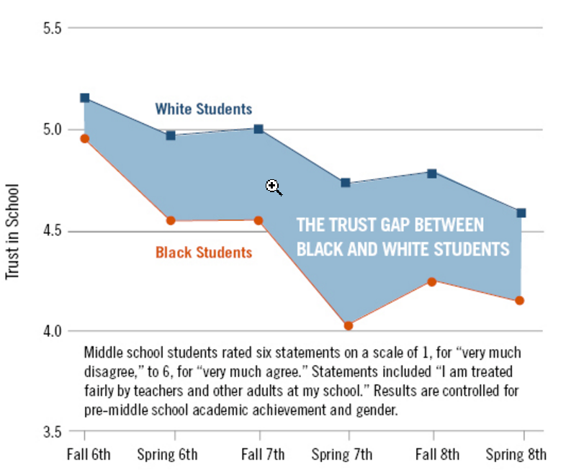
Academic Engagement
Notes:
When School Doesn't Seem Fair, Students May Suffer Lasting Effects
Teachers’ ‘wise feedback’ to students may help
By Evie Blad
February 14, 2017
When students believe schools are unfair places, their loss of trust can lead to a lack of engagement that affects them for years, researchers say.
Students who perceive a lack of justice or disparate treatment for certain racial groups may respond with defiant behavior.
And discipline for that behavior may cause them to become further disengaged from school, fostering a spiral of defiance that may lead to poor outcomes, such as less likelihood of college enrollment, researchers from the University of Texas at Austin and Yale and Stanford universities write in a paper published last week.
Black and Hispanic students, who often bear the brunt of inconsistent school discipline, are less likely than white peers to trust their schools, the researchers found.
Relationships between students and educators are key to interrupting that cycle or stopping it from beginning in the first place, the researchers suggest.
"Wise feedback"—interactions that show teachers have high standards for students and believe in their potential—can increase their trust, they found in a smaller, simultaneous experiment. Their findings, published in the journal Child Development, fit into a growing body of research that emphasizes the positive effects of building trusting relationships between students and their teachers and ensuring supportive and fair treatment in discipline and other areas.
"When we're creating school policies, we're not just maintaining order, we're teaching teenagers about how society works, and they use those lessons—those teachable moments—going forward," said David Yeager, an assistant professor of developmental psychology at University of Texas at Austin, who led the study.
The Trust Gap Between Black and White Students
Middle school students rated six statements on a scale of 1, for “very much disagree,” to 6, for “very much agree.” Statements included “I am treated fairly by teachers and other adults at my school.” Results are controlled for pre-middle school academic achievement and gender.
A 'Trust Gap'
The researchers surveyed 277 black and white students at an unidentified middle school twice a year for three years on the amount of trust they placed in their school and their perceptions of bias in school policies. They followed up with those students for years, tracking their disciplinary incidents and, later, whether they enrolled in a four-year college the year after graduation.
The survey asked students to rank six statements—including "students in my racial group are treated fairly by teachers and other adults at [school name] middle school"—on a scale of 1, for "very much disagree," to 6, for "very much agree."
To detect a perception of bias, the researchers asked students to respond on a 5-point scale to questions like, "If a black or a white [school name] student is alone in the hallway during class time, which one would a teacher ask for a hall pass?" Students answered 1 for "almost always the black student," 3 if they expected students of both races to be treated the same, and 5 for "almost always the white student."
Tracking results, researchers found black and white students had similar responses on the trust survey at the start of 6th grade, but a "trust gap" developed by the spring of 7th grade, when black students' average school trust score dropped to its lowest. That's also when black students were most likely to sense inequitable treatment, with their average score on the bias scale falling below 2.5 while their white peers' average score hovered near 3.
And it wasn't just a perception; there was real evidence of bias at the school, the study says, noting that only black students received discipline for broad, subjectively interpreted infractions like "defiance."
Researchers also detected a cycle: A higher perception of bias led to a lower sense of school trust at the end of 7th grade, students with a lower sense of school trust were more likely to be cited for discipline in their 8th grade year, and students with higher discipline rates were later less likely to be enrolled in a four-year college.
Seventh grade seemed particularly critical. Among black students whose trust declined during that year, 43 percent later had on-time enrollment at a four-year college, compared with 64 percent of black students whose trust increased, Yeager said.
In a second study, researchers found similar gaps in trust and perceptions of bias between whites and Hispanics at another middle school, but did not track effects on discipline and college-going rates.
To test whether teachers' actions could counteract factors that caused students to lose trust in their school, the researchers pulled a subset of 88 7th graders with B and C grade point averages from the first experiment. Students in a control group had a note from a teacher placed on an essay they had written that said: "I'm giving you these comments so that you'll have feedback on your paper." Students in the experimental group instead received a note that spoke to their potential as individuals: "I'm giving you these comments because I have very high expectations and I know that you can reach them."
Response to Encouragement
Given the chance to revise their essays, black students in the experimental group were more likely to make changes suggested by the teacher. They also showed less loss of trust over time than their peers in the control group and they had fewer discipline incidents the next year. The researchers emphasized that the experiment used a small sample of students, and that a teacher's encouraging note would not remedy all distrust.
"Of course, truly 'wise' educators do not simply append notes to essays and end their interventions there," the study says. "Instead, they stay mindful of their students' perspectives, and let this awareness continually inform their practices in word and in deed."
The finding that changes to how adults interact with students can influence students' attitudes and, subsequently, their behavior, is supported by a growing body of evidence. Researchers at Stanford recently found that an exercise designed to promote empathy in teachers led to lower suspension rates.
Similarly, a Rutgers University study found that having veteran teachers coach younger peers had an unexpected outcome: an elimination of racial disparities in discipline rates in their classrooms.
That coaching model, called "My Teaching Partner," was developed at the University of Virginia. It emphasizes "holding high expectations for all students in the classroom, individualizing supports, and trusting students" by giving them more choices in the classroom, said Bridget Hamre, the associate director of the Center for the Advanced Study of Teaching and Learning at UVA. For example, teachers may seek students' insights when they introduce new concepts, she said.
"It's anything that shows them that you're authentically interested in understanding their perspective in how the world works," Hamre said. And students whose teachers had the training seemed to respond to their teachers' trust in kind, which led to the surprising disciplinary outcomes, she said.
Changes in teacher behavior seemed to have greater effects on students of color because they've been traditionally marginalized by education systems, researchers say.
"We find that students who chronically had mistrust benefited the most [from receiving an encouraging note]," Yeager said. "A surprising instance of an adult taking you seriously can be a spotlight memory, something you look back to, a turning point."
Coverage of learning mindsets and skills is supported in part by a grant from the Raikes Foundation, at www.raikesfoundation.org. Education Week retains sole editorial control over the content of this coverage.
Vol. 36, Issue 21, Pages 1, 10-11

Slide 79
*NOTE - In slide show mode click mouse to advance animation
PDCA Path
Low reading achievement leads to increased attentiveness
Reciprocal Effects
Inattentive behaviors have strong negative effects on reading
Reading
Behavior
Academic Engagement

Slide 80
Sample Resource

Slide 81
Acceptability Applied to Students
Ask Students
Use a Survey Measure (ex. KIP – Kids Intervention Profile – Eckert et al)
Here’s Kim

Slide 82
7 Steps to Intervention Fidelity
Is Procedure Accurate & Sticking
Adherence
Student Engaged
Skill- ed
Intensity
T
Engag-ed
Inter-vention
Need
Coulter & Gibbons, 2017

Slide 83
Systematically Measure Fidelity as Feedback on Training & Support
No Surprises (presented in ‘Training’)
Unacceptable Scores - Reflection of What?
Checklists as Common Method
Adherence
Coulter & Gibbons, 2017

Slide 84
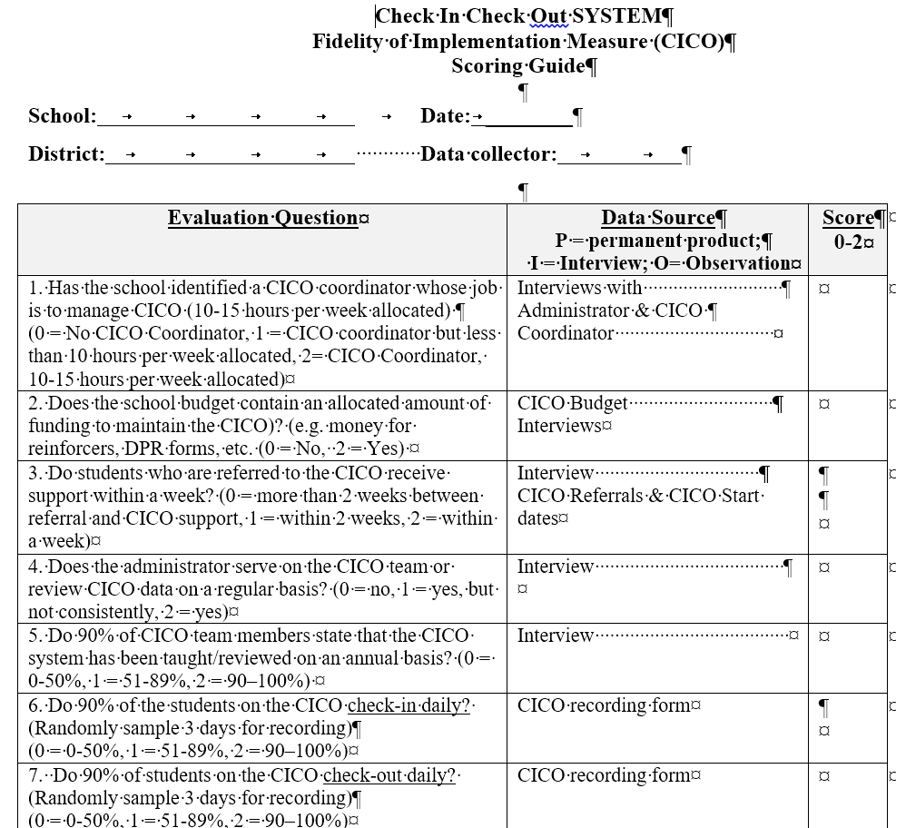
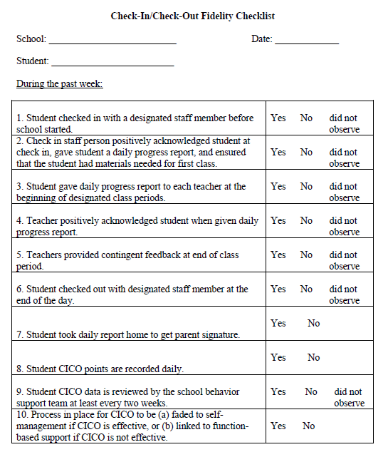
Check-In Check-Out Fidelity Measures

Slide 85
Focus on the System

Slide 86
Focus on the Adult & Student

Slide 87
5 Steps to Using Any Implementation Fidelity Measurement
1. Select a Measure
2. Ask Teachers for Feedback on Social Validity
3. Co-Edit w/Guidelines
4. Teachers Use Measure w/Each Other
5. School Leaders/PLCs use the Measure to Improve Performance & Results

Slide 88
Common Errors in Developing Checklists
Too Many Items (Not More than 10)
Not Time-Bound
Not Co-Created or Co-Edited
Imposed on Users

Slide 89
How to Create An Integrity Checklist. . .

Slide 90
Core Questions
What does the intervention Look like when it’s in Use?
What would be Seen in classrooms where it is Used?
What will teachers and students be Doing when the intervention is in Use?
(Hall & Hord, 2001)

Slide 91
Making the Checklist
Identify the Steps in Intervention
Create an Item for Each Step
Yes/No Response for Each Item
Not more than 10 items (5?)

Slide 92
Duet Reading
Purpose
Student and teacher alternate words as they read the same passage together
Provides support for tracking, a delayed model for accurate reading, and establishes a slightly faster reading pace

Slide 93
Duet Reading
Materials
Short texts that the student can read with at least 95% accuracy
Long enough that the student will be able to almost complete the passage in 1 minute after practicing the duet procedure

Slide 94
Duet Reading: Sequence
First Reading
Student reads the passage aloud. Teacher provides immediate standard error corrections.
“That word is _______. What word?” The student repeats the word. Teacher says, “Yes. That word is _______.” Student goes back to the beginning of the sentence to begin again.
Teacher counts back (me you me you me you)

Slide 95
Duet Reading: Sequence
Second Reading
Teacher and student take turns reading EVERY OTHER WORD. Teacher first this time.
Teacher should read with excellent expression to avoid typewriter style output.
Teacher should push the pace forward by reading each next word as soon as the student read the last word. Teacher provides standard error corrections immediately following any error.
“That word is _______. What word?” The student repeats the word. Teacher says, “Yes. That word is _______.” Student goes back to the beginning of the sentence to begin again.

Slide 96
Duet Reading: Sequence
Third Reading
Teacher and student take turns reading EVERY OTHER WORD. Student first this time.
Teacher continues to model excellent expression and to press the pace forward.
Teacher provides standard error corrections immediately following any error.
“That word is _______. What word?” The student repeats the word. Teacher says, “Yes. That word is _______.” Student goes back to the beginning of the sentence to begin again.

Slide 97
Duet Reading: Sequence
Fourth Reading
Student reads the entire passage out loud alone.
May repeat sequence with a second passage, or the next section of the same passage

Slide 98
Example

Slide 99
Scoring the Checklist
Observe the intervention in action
For each checklist item evaluate - Was that step completed? Y or N
Total “Yes” Responses
Divide the number of “Yes” responses by the total number of items on the checklist
Integrity percentage yielded!

Slide 100
Adjustments Made
Criterion for Acceptable Fidelity ?
Follow Plan Developed During Training
Notes:
100

Slide 101
What’s the Magic Number for Fidelity?
Applying Concepts of Implementation Fidelity
80%
Or 100% ?
Coulter & Gibbons, 2017

Slide 102
Summary: Key Factors in Fidelity
7 Pieces Implies Fidelity is Complex
Collaborative Culture is Essential – Builds Ownership
Not Evaluation of Implementer. Helps Everyone (Trainer to Teacher or Interventionist to Student)
Never a Punitive Exercise
Back to Alan

Slide 103
Key #3 Assess Yourself to Expand Your Expertise
Notes:
Alan

Slide 104
Next Step: Applying Concepts of Implementation Fidelity
Element | Your Strength | Your Challenge | One Action I could Take
Need Well Defined
Program Specificity
Interventionist Engagement
Training & Support
Exposure & Duration
Student Engagement
Adherence
Find Your Handout Tool
Notes:
7 Rows – 1 for Each Component

Slide 105
3 Keys 1. Expand Your Working Conception of Fidelity 2. Carefully Design the Dosage 3. Assess Yourself to Expand Your Expertise

Slide 106
7 Steps to Intervention Fidelity
Sustained
Desired Outcome
Success
Adherence
Student Engaged
Skill- ed
Intensity
T
Engag-ed
Inter-vention
Need
Coulter & Gibbons, 2017

Slide 107
Careful – This is an Iterative Process
5
3
2

Slide 108
Don’t Be Anxious about Repeating a Step (or Two)

Slide 109
Review: Key Factors in Fidelity
7 Pieces Implies Fidelity is Complex
Collaborative Culture is Essential – Builds Ownership
Not Evaluation of Implementer. Helps Everyone (Trainer to Teacher or Interventionist to Student)
Never a Punitive Exercise

Slide 110
Next Step: Applying Concepts of Implementation Fidelity
Element | Your Strength | Your Challenge | One Action I could Take
Need Well Defined
Program Specificity
Interventionist Engagement
Training & Support
Exposure & Duration
Student Engagement
Adherence
Find Your Handout Tool
Notes:
7 Rows – 1 for Each Component

Slide 111
Summary: What Actions Could You Take ?
Following this Session You Could:
Self-Assess Your Strengths in Implementing Interventions with Fidelity
Plan a Protocol to Improve Installation of an Intervention.

Slide 112
Closing Activity
From your self-assessment, pick two things you plan to do when you get back to your district. Compare your two things with your neighbor to see whether your plans for action are the same or different.

Slide 113
You Must Have Questions!
Who Has All the Answers ?
kgibbons@umn.edu

