Slide 1
General Supervision System
Role and Responsibilities of the MDE and ISDs in Ensuring FAPE
Michigan Association of School Psychologists
November 7, 2019

Slide 2
Individuals with Disabilities Education Act
An American Civil Rights Law

Slide 3
Due Process to Protect A Civil Right
…The child is educated as close as possible to the child’s home (34 CFR 300.116(b)(3))
…the child is educated in the school that he or she would attend if nondisabled (CFR 300.116(c))

Slide 4
Least Restrictive Environment (LRE) is NOT a placement
LRE is central to the requirements of IDEA
LRE is a set of considerations for EACH student with a disability that balances:
A student’s civil right to be educated with nondisabled peers in the district, building, classroom they would be in if they did NOT have a disability AND
The district’s obligation to offer a FAPE based on individual student needs and the impact of the disability

Slide 5
Governing Regulations
Federal
State of Michigan
Individuals with Disabilities Education Act (IDEA)
Federal statue and regulations defining:
Entitlements for students with disabilities
Obligations of schools to provide a Free Appropriate Public Education
Part B: Students 3-21
Part C: Children Birth-3
Michigan Administrative Rules for Special Education (MARSE)
13 categories of eligibility/program descriptions
Certification/endorsements
State Complaint
Finance
ISD Plans
Section 619: Children 3-5

Slide 6
Additional requirements governing a Federal special education grant

Slide 7
Section 608: State Administration
(a) Rulemaking.—Each State that receives funds under this title shall—
(1) ensure that any State rules, regulations, and policies relating to this title conform to the purposes of this title;
(2) identify in writing to local educational agencies located in the State and the Secretary any such rule, regulation, or policy as a State-imposed requirement that is not required by this title and Federal regulations; and
(3) minimize the number of rules, regulations, and policies to which the local educational agencies and schools located in the State are subject under this title.
“Ensure that any State rules, regulations, and policies relating to this title conform to the purposes of this title.”

Slide 8
SEA Responsibility for General Supervision (IDEA §612(a)(11))
The SEA is responsible for ensuring that:
The requirements of IDEA Part B are met;
All educational programs for children with disabilities in the State, including all such programs administered by any other State agency or local agency—
are under the general supervision of individuals in the State who are responsible for educational programs for children with disabilities; and
meet the educational standards of the SEA.

Slide 9
IDEA §612(a)
FAPE is made available to all children with disabilities age 3 through 21 residing in the State within the State’s mandated age range;
Child find is conducted for all children with disabilities residing in the State who are in need of special education and related services;
Evaluations are conducted;
IEPs are developed and implemented;
LRE requirements are met; and
All other conditions in section 612(a).

Slide 10
IDEA Part B Subgrants (34 CFR §300.200)
States that receive a section 611 or 619 grant must distribute any funds not reserved for State-level activities to all eligible LEAs in the State.
An LEA is eligible for assistance under IDEA Part B for a fiscal year if the agency submits a plan that provides assurances to the SEA that the LEA meets each of the conditions in §§ 300.201 through 300.213.
(emphasis added)

Slide 11
Conditions of eligibility for IDEA Part B Subgrant
The LEA, in providing for the education of children with disabilities within its jurisdiction, must have in effect policies, procedures, and programs that are consistent with the State policies and procedures established as required in IDEA §612. (emphasis added)

Slide 12
Selected Conditions of LEA Eligibility
Use of funds
Excess costs
Maintenance of effort
Use of appropriate/adequately trained staff
Treatment of charter schools
Providing SEA with information necessary to enable the SEA to carry out its duties under IDEA Part B

Slide 13
Michigan’s 56 ISDs = LEAs
Subrecipient of IDEA Funds
Therefore, ISDs in Michigan are responsible for ensuring Part B requirements are met.

Slide 14
Educational Service Agencies (34 CFR §300.28(b))
The term LEA includes an educational service agency, as defined in 34 CFR §300.12(b).
An SEA may only provide Part B subgrants to eligible LEAs. In order to receive a Part B subgrant, an ESA, like any LEA, must establish eligibility under IDEA section 613.
Because Michigan provides Part B subgrants to ISDs, the LEA eligibility requirements apply to the ISD.
The LEA that establishes eligibility under IDEA section 613 and receives a Part B subgrant is the LEA responsible for ensuring Part B requirements are met.

Slide 15
Michigan Administrative Rules for Special Education (MARSE)
Intermediate School District Responsibilities
Each intermediate school district shall implement monitoring procedures and evaluation methods developed by the department to ensure that the standards and criteria established are being achieved by the intermediate school district, their constituent local school districts, and their public school academies.
Source: MARSE R 340.1839 Monitoring and program evaluation. Rule 139

Slide 16
Clarify Roles and Responsibilities at the State and ISDs
Strengthening partnerships to improve student outcomes

Slide 17
IDEA Supervision: Coordination and Communication

Slide 18
IDEA Supervision: Coordination and Communication

Slide 19
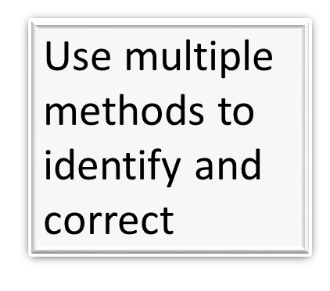
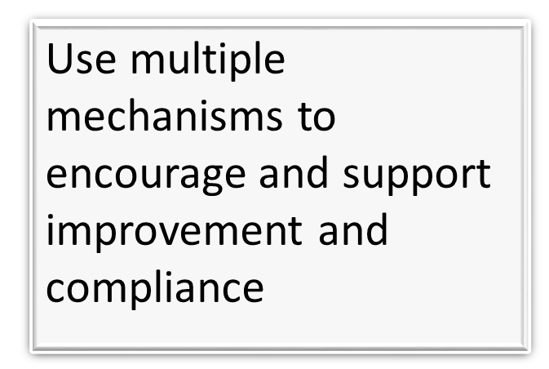
Effective Systems of General Supervision

Slide 20
Components of General Supervision and IDEA Accountability Systems
State Performance Plan, including the State Systemic Improvement Plan
Professional Learning and Development and Technical Assistance
Policies, Procedures, and Effective Implementation of Evidence-based Practices
Data on Results
and
Processes
Fiscal Management and Accountability
Integrated Monitoring Activities
Effective Dispute Resolution
Improvement, Correction, Incentives, and Sanctions
Original Source: Concepts of General Supervision: Accountability for Implementation & Improved results. National Center for Special Education Accountability Monitoring (NCSEAM), 2007. Adapted and Updated Source: Jane Nell Luster, Ph.D., Com-Link, LLC

Slide 21
System of General Supervision
Supporting a shared obligation to ensure and to increase the capacity to provide FAPE in the LRE to eligible students with disabilities across Michigan.

Slide 22
Components of General Supervision and IDEA Accountability Systems
State Performance Plan, including the State Systemic Improvement Plan
Professional Learning and Development and Technical Assistance
Policies, Procedures, and Effective Implementation of Evidence-based Practices
Data on Results
and
Processes
Fiscal Management and Accountability
Integrated Monitoring Activities
Effective Dispute Resolution
Improvement, Correction, Incentives, and Sanctions
Original Source: Concepts of General Supervision: Accountability for Implementation & Improved results. National Center for Special Education Accountability Monitoring (NCSEAM), 2007. Adapted and Updated Source: Jane Nell Luster, Ph.D., Com-Link, LLC

Slide 23
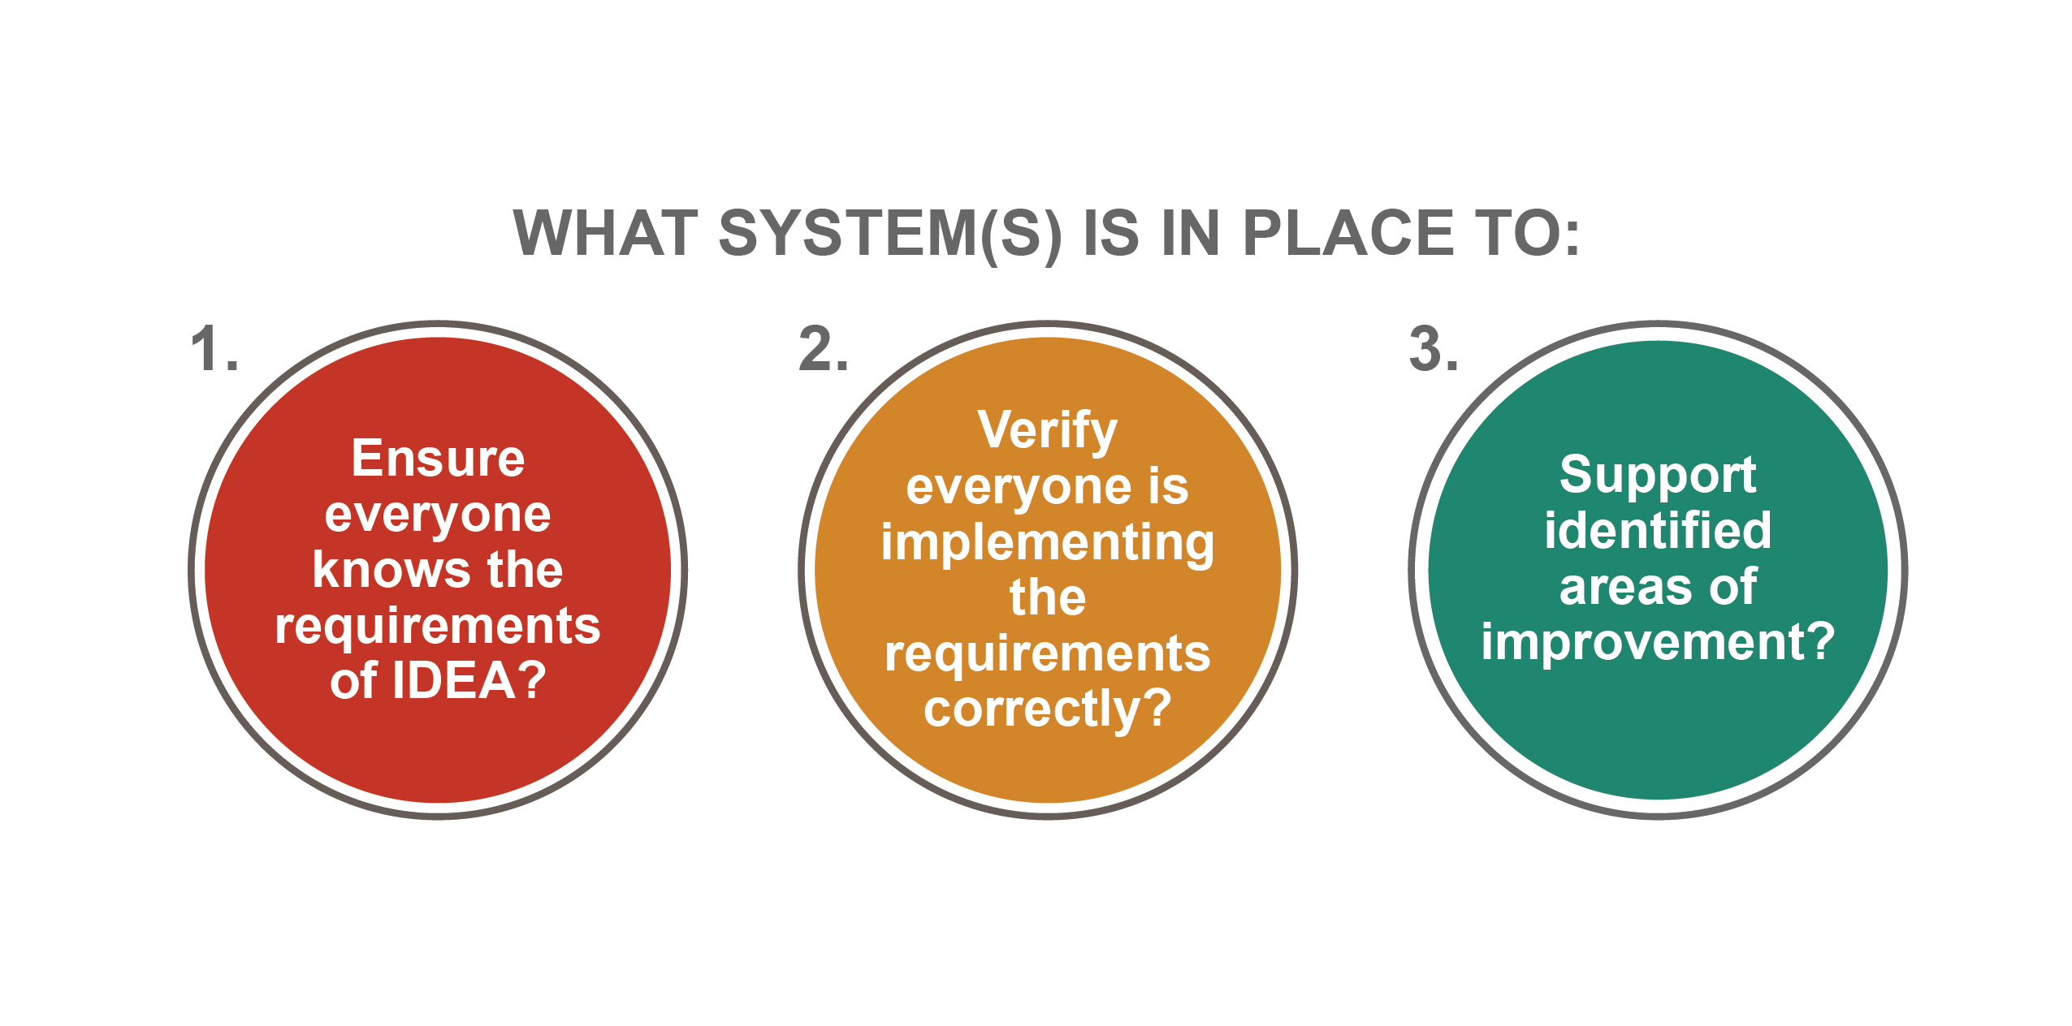
The Three Questions…at every level

Slide 24
Ensure Provision of a FAPE

Slide 25
Least Restrictive Environment (LRE) is NOT a placement
A student’s category of eligibility does NOT determine placement
Program or placement is to be individually determined based on the specific needs of a student with a disability. For example:
A student with a cognitive impairment is not automatically placed in a program for cognitive impairment
A student with a hearing impairment is not automatically placed at the Michigan School for the Deaf

Slide 26
Improving a System…Improving Outcomes
Comprehensive Evaluations…appropriate identification
Behavior cannot be a barrier to learning…using the strategies under IDEA
Functional Behavior Assessments
Behavior Intervention Plans
Multi-tiered Systems of Support (MTSS)
Positive Behavioral Intervention & Supports (PBIS)

Slide 27
Questions about special education?
Contact us!
Call us!
Toll Free OSE Information Line
888-320-8384
Monday-Friday
9:00-4:00
mde-ose@michigan.gov
Teri Chapman, Director
517-335-0455
chapmant2@michigan.gov

Slide 28
Thank you!!
Great things are not done by impulse, but by a series of small things brought together. ~Vincent Van Gogh

