Slide 1

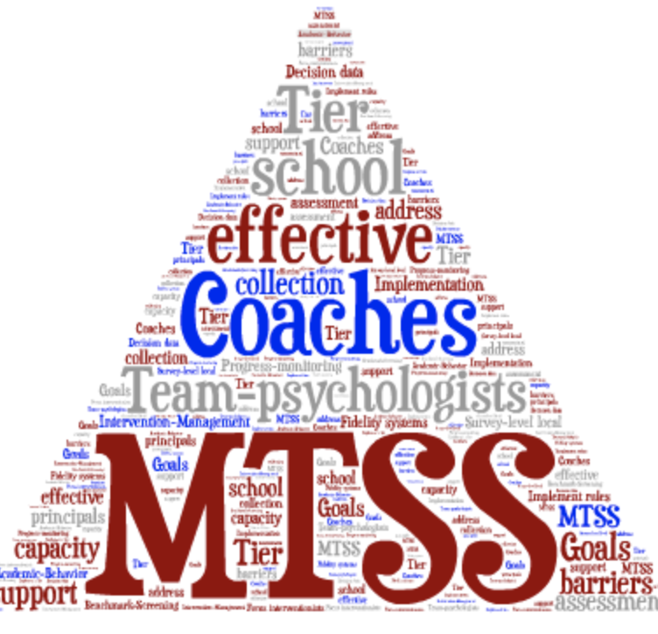
SLD Eligibility Within an MTSS Framework: Necessary Components for Effective Decision-Making
Presented By:
Kim Gibbons, Ph.D.
kgibbons@umn.edu
University of Minnesota
Ohio School Psychology Association
November 8th, 2017

Slide 2
Agenda: Let’s Talk About SLD Eligibility
Why MTSS?
What are the Big Ideas about Eligibility?
Review and reflect the ”Big 5” components needed for implementation and sustainability of MTSS.
  Assessments
  Decision Making
  Multilevel Instruction
  Infrastructure and Support
  Fidelity and Evaluation
How Does SLD Entitlement fit within the Framework?

Slide 3

Opening Activity
Ask two people near you what they want to learn this morning.

Slide 4
Filter (2007) survey of practicing school psychologists in Minnesota
152 respondents
Completed online survey including questions about
  Number of hours spent per week in various professional activities
  Self-reported need for additional training in each area of practice (1-3 Likert scale – 1=no need to 3=significant need)

Slide 5
Filter (2007) Survey Results – Top 5 activities by average hours per week
Writing reports
IQ testing
Consulting with school staff
Participating in Special Education eligibility meetings
Administering and scoring behavior rating scales

Slide 6

A New Role: School Psychologists as Super heros!

Slide 7
School Psychology Super Hero Skills
Knowledge of Data
Assessment Skills
  RIOT and ICEL
Evidence-Based Interventions and Instructional Practices
Instructional Consultation
Behavioral Consultation
Problem-Solving Model for Decision-Making

Slide 8

Lost in the Woods
A group of managers got lost in the woods. Undaunted they organized into several teams and began hacking a path through the dense undergrowth. Hours passed, but the managers were cheerful. They had become an efficient “operating unit” and were proud of their achievement.

Slide 9

Lost in the Woods
One of the group decided to climb a tree to see how far they had come. But the woman shouted down, “Stop!” We are headed in the wrong direction. We have to change course.”
The managers shook their heads in disbelief and defiance and said, “But we can’t stop now; We are making great progress!”

Slide 10
Moral of the Story
It’s hard give up what we do well, even if it is no longer relevant.
We must continually reassess our direction.
Implement research-based instruction to increase achievement levels of all students.

Slide 11
Thought for Today
The difficulty lies, not in the new ideas, but in escaping from the old ones, which ramify, for those brought up as most of us have been, into every corner of our minds.
John Maynard Keynes (1883 - 1946), The General Theory of Employment, Interest and Money (13 December 1935)

Slide 12
What We Need To Do!
1. Embrace a Fundamental Belief
3. Create Urgency & Conviction
2. Understand
If We Keep Doing What We have been Doing, We will Keep Getting What We have been Getting: Great Variability in Outcomes & Further Disadvantaging of the Most Disadvantaged
All Children Can Learn Despite Many Obstacles Outside Our Control
We Can & Must Do Better for Large Numbers of Students!

Slide 13
MTSS
Is not just a process of providing interventions to a small group of students.
Is a school reform model that involves new ways of thinking and doing business in education.

Slide 14
Thoughts on Sustainability
It’s hard to sustain practices over time with fidelity.
MTSS is like a recipe. It’s not a McDonald’s ”value menu” where you like one part but not another part.
It takes time to understand it’s a system and it all interacts with each other.
You can’t pick and choose!

Slide 15
Solutionitis
JUMP
Solutionitis
Quickly on a solution before understanding the problem.
Research Base.
Ideas move quickly
Lack
Popular
Ideas become the new hammer.
Hot

Slide 16
Implementation: The Big Five!
Assessments
Data-Based Decision Making
Multilevel Instruction
Infrastructure & Support
Fidelity & Evaluation

Slide 17

Why
MTSS?

Slide 18



Why MTSS?
Increase achievement for all students
Non-discriminatory assessment practices
Increase collaboration
Allocate resources based on needs
Unified framework of academics and behavioral support
High rates
of referrals for special education

Slide 19
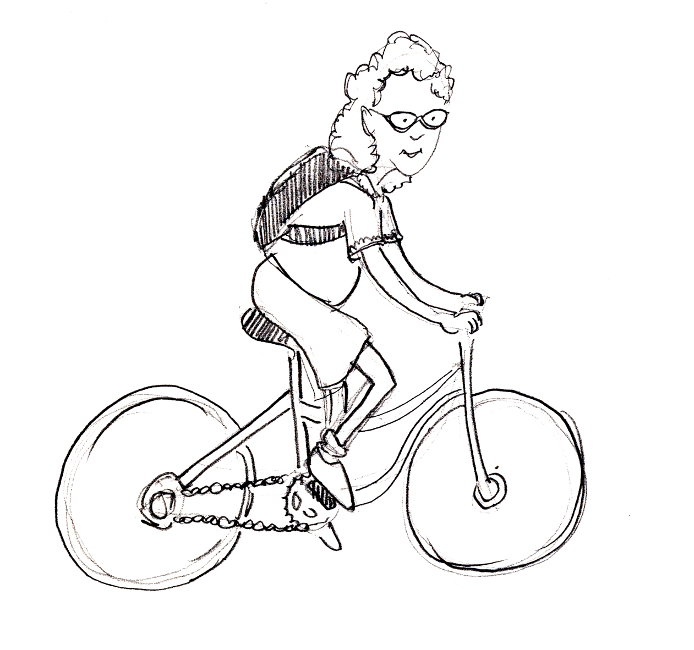
Clarissa
5th grade student
99th percentile in reading, math, science
Has met 8th grade
targets
Is she applying
herself

Slide 20

Zachary
7th grade student
Grade-level reading and math
A’s and B’s on report card
Likes school
No reported concerns from parents or teachers

Slide 21

Cassie
9th grade student
Partially proficient on MCA reading since 4th grade
Below target on
school-wide screening since 4th grade
Struggles to keep up
She’s not sure she
is college material

Slide 22
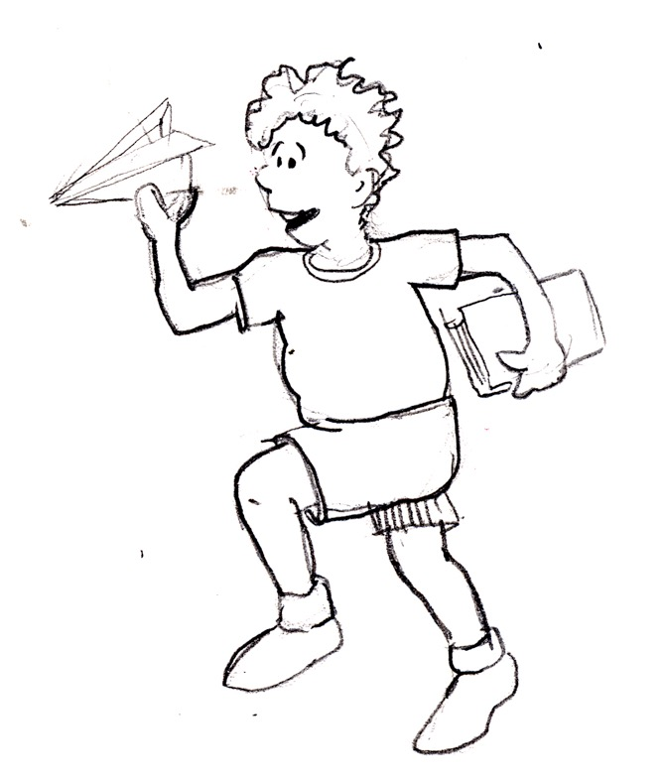
Jesse
Second grade student
4th percentile in reading
2nd percentile on MAP test
Frequent disciplinary referrals
Little progress after two years of supplemental interventions

Slide 23

What are the Big Ideas around MTSS and Eligibility?

Slide 24

Big Idea #1: There is not a right way to do a wrong thing.

Slide 25
The SLD IQ Test - True or False
IDEA ’04 prohibits the use of I.Q. tests in the identification of specific learning disabilities (SLD).
Response to Intervention (RtI) is required by IDEA ’04 in order to identify SLD.
To adequately identify SLD a test of cognitive processes is essential to determine goals for the individual educational program (IEP).
When conducting an intervention as part of RtI, it is essential to measure the fidelity of implementation.
Determining a child eligible for special education services as having SLD usually results in a better educational outcome (i.e. earning a high school diploma, etc.).

Slide 26
The SLD I.Q. Test
The ability-achievement discrepancy model meets APA standards for reliability.
The ability-achievement discrepancy model meets APA criteria for validity.
The current six component definition of specific learning disabilities (IDEA ’97) is supported by more than 30 years of research on SLD.
Students who receive ineffective instruction in reading in early grades develop persistent reading problems that are resistant to intervention, including special education, in middle and high school.
Notes:
(No evidence, based on expert judgment at the time)

Slide 27
True or False
Screening and evaluation of academic skills for all students in early grades is too costly and inefficient for use by schools.
Identification of SLD at grades 4 to 7 results in the most beneficial outcomes for those students (increased high school diplomas, etc.).
Identification of SLD using the ability-achievement discrepancy approach is cost efficient (standardized & reliable routine professional practices).

Slide 28
Doing the right thing
Why do we continue to allow a model that is invalid and does not contribute to better outcomes for students?
What is wrong with comparing students to local expectations and standards and making decisions about resources and interventions based on student need?
Why do we continue struggling with demarkation points for entitlement?
Why is it so hard to do the right thing?

Slide 29
Problems with Current System
Four major themes in classifying students:
  Current categories for students classified as LD are arbitrary, inconsistent, and unreliable.
  Considerable variation exists between states on definitions of formulas to use.
  Greater emphasis needs to be placed on the LRE and the design of effective instructional environments rather that the assessment of students to determine eligibility.
  Wait to Fail approach
Notes:
29
Kim

Slide 30
Cognitive Processing?
"The Department does not believe that an assessment of psychological or cognitive processing should be required in determining whether a child has an SLD. There is no current evidence that such assessments are necessary or sufficient for identifying SLD. Further, in many cases, these assessments have not been used to make appropriate intervention decisions (page 649 of final regulations)."
Notes:
30

Slide 31
Cognitive Processing and Evaluations
A comprehensive evaluation could include an assessment of cognitive processes.
A comprehensive evaluation is required.
There is no mandate for anything in the comprehensive evaluation
No support for cognitive processing requirements in preamble
Notes:
31

Slide 32
A few tips from Jim Ysseldyke
We need to move from sifting and sorting to multi-tiered serving.
We need to shift our focus from struggling students to making sure all students struggle.
The best place to start correcting learning problems is in the instructional process.
Keep our focus on assessment practices that matter!
Focus on Alterable Variables
Notes:
We spend far too much time making predictions about students’ lives, and far too little time making a difference in their lives.
We have new subtypes of conditions and subtypes of subtypes. We have invented new processes or abilities for students to be deficient in.(Ysseldyke, 2009)
Keep the focus on Really Terrific Instruction!

Slide 33

Focus on Alterable Variables
Spend less time making predictions about students' lives and more time finding ways to make a difference in their lives.

Slide 34
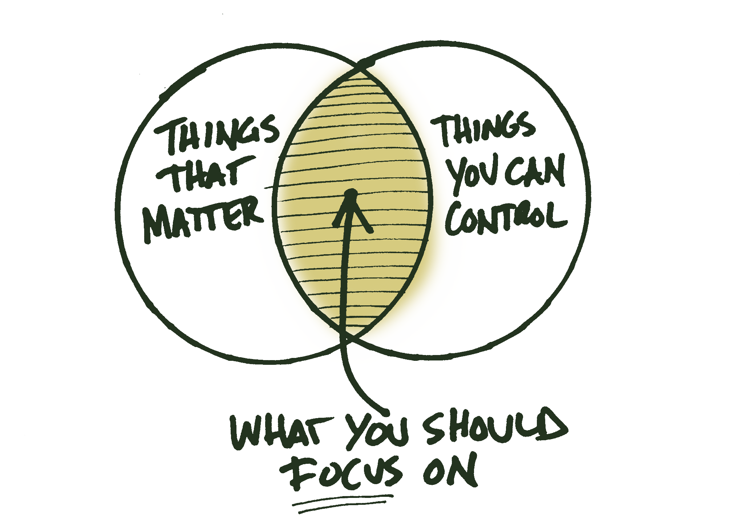

Slide 35

If the water in the aquarium is dirty,
don’t spend time diagnosing individual fish.

Slide 36

Don't diagnose the fish,
change the water.

Slide 37

Instruction
Environment
Curriculum
Organization
water.
Notes:
37
37

Slide 38
The question needs to change!
Shift the question we are asking from:
“What about the student is causing the performance discrepancy?”
to
“What about the instruction, curriculum, & environment should be altered so that students will learn and be more successful?”

Slide 39

Old Thinking
https://www.youtube.com/watch?v=cKMn-_aQoPk

Slide 40

MTSS…
Old Thinking
New Thinking
An instructional program
A framework to implement effective practices
The old way of doing business with a new label (pre-referral intervention)
Proactive and data-driven
Intended to encourage
placement of students
Matching needs and resources
Possible to implement alone
A collaborative effort
The same for every school
Uniquely designed for each site
A special education, a general education, a Title 1, a talented
and gifted initiative
An every education initiative focusing on system change

Slide 41
What We Were Getting: The Old Way
Siloed System of General and Special Education with not much in between.
Students with the most intensive needs at each grade level didn’t EVER qualify for services despite having identical needs to students who did qualify.
Many students with intensive needs didn’t qualify until 4th or 5th grade resulting in a Wait to Fail Model.

Slide 42
New Thinking
Every Problem Learning is NOT a Special Education Problem, But Requires Early and Intensive Intervention
Identifying What the Student “NEEDS” Is the Key to Any Assessment Activity
If You NEED Something (Intensive Intervention), You GET Something (Appropriately Intensive Intervention)
Early Intervention MUST Be Driven by Universal Screening, Especially K-6, Not Referral

Slide 43
New Thinking
General Education Must Provide Stronger Core, Research-Based Programs AND a Broader Range of Appropriately Intensive Interventions
Intervention is PROACTIVELY DESIGNED. Figure Out WHAT We Do, THEN Figure Out WHO NEEDS IT!
Special Education Needs to Focus on Results, not Just Compliance and that Means Increasing Research-Based Practices and Intensity of Intervention

Slide 44
What I Know after 13 years of Implementing a Better way
  The floodgates did not open.
  Achievement increased for all students.
  IQ tests are no longer needed for SLD and this frees up TIME.
  Treatment integrity should not be optional.
  Instructional match continues to be a problem.
  State definition of ROI can be a problem.
  National and state comparisons don’t always make sense.

Slide 46

Big Idea #2: MTSS is about improving outcomes, not just about qualifying for services

Slide 47
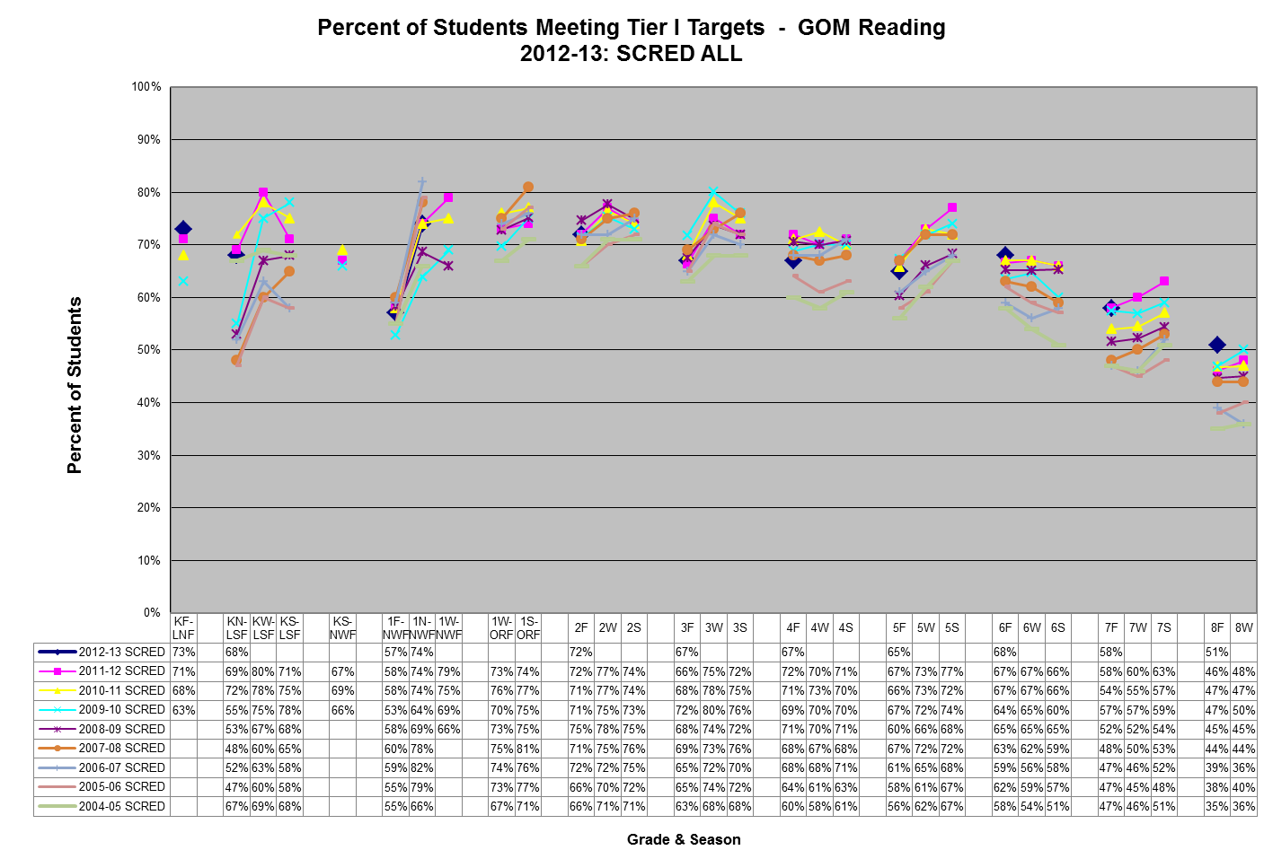
Average proficiency in 1996
Notes:
Much of the GOM Reading data dates back to 1996 -97, but this slide only goes back to 2004-05
2009-10 was the first year NBAPS was with SCRED
Celebrations and Concerns
More students (between 1-5%) meeting TIER I targets in Fall 2012 in the following areas/grades: KF-LNF, 3rd, 6th and 8th grade ORF, strong performance in 7th and 8th grade ORF
Fewer students (between 1-5%) meeting TIER I targets in Fall 2012 in the following areas/grades: KN-LSF, 1F-NWF, 4th and 5th grade ORF

Slide 49
Medium
0.4
0.15
Low
Desired
Effects
Teacher
0.7
High
0.0
Developmental
Negative
1.0
Reverse
-0.2
1.2
S
Response to Intervention
(MTSS)
d = 1.07
Notes:
Insanely high effect size

Slide 50
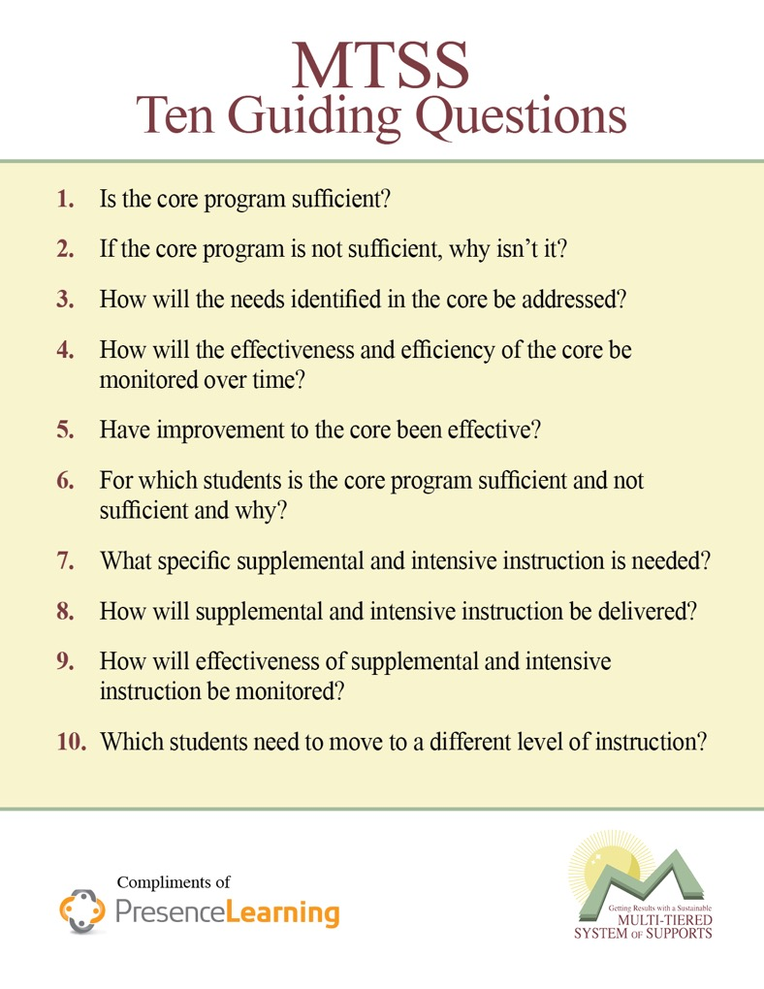

Slide 51
With a partner:
  Review the 10 essential questions
  What questions are being addressed in your building?
  What questions need more discussion?
Pop-Up

Slide 52

Big Idea #3: Data are not optional but we have to be Data Literate!

Slide 53

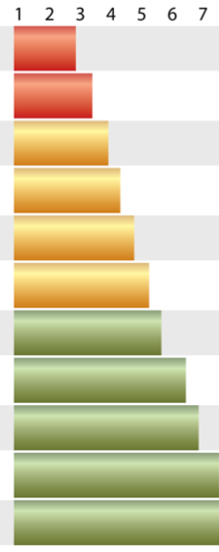

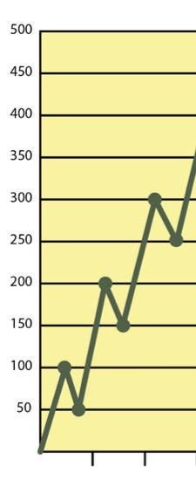

Assessments
PM
Tools
PM
Process
Tools
Screening
Data

Slide 54
Assessments
Tools
Screening
Data
PM
Tools
PM
Process
Tools should be reliable and valid. Staff should
be able to articulate how and why they are.

Slide 55
Assessments
Tools
Screening
Data
PM
Tools
PM
Process
Screen all students. Collect data multiple times per year to ensure implementation accuracy for making decisions.

Slide 56
Assessments
Tools
Screening
Data
PM
Tools
PM
Process
Use screening data plus two other data sources that paint a picture of each student’s progress.

Slide 57
Assessments
Tools
Screening
Data
PM
Tools
PM
Process
Compare performance using multiple forms with equal difficulty. Benchmark in fall, winter and spring.

Slide 58
Assessments
PM
Tools
PM
Process
Assessments
Tools
Screening
Data
Develop schedules and put procedures in place to ensure that the process is being implemented accurately.

Slide 59
Data Literacy
The Key to Success
Purposes of Assessment
Screening
Diagnostic
Progress Monitoring
Outcomes

Slide 60

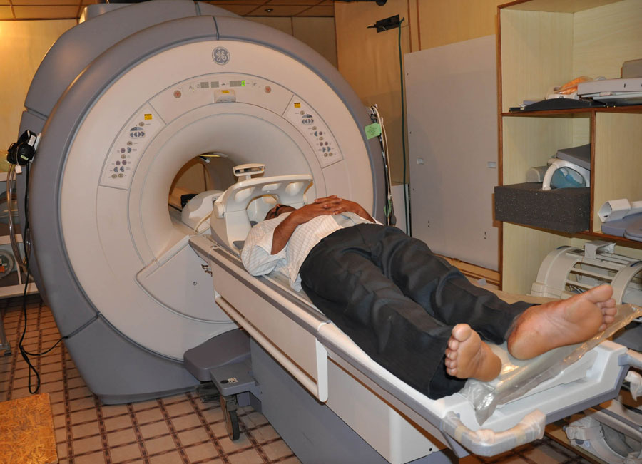
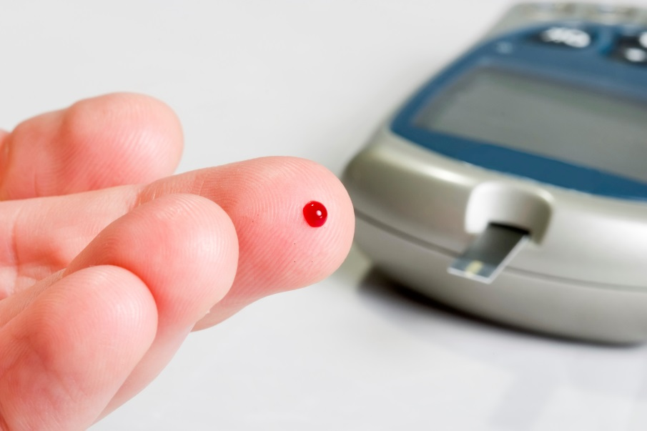
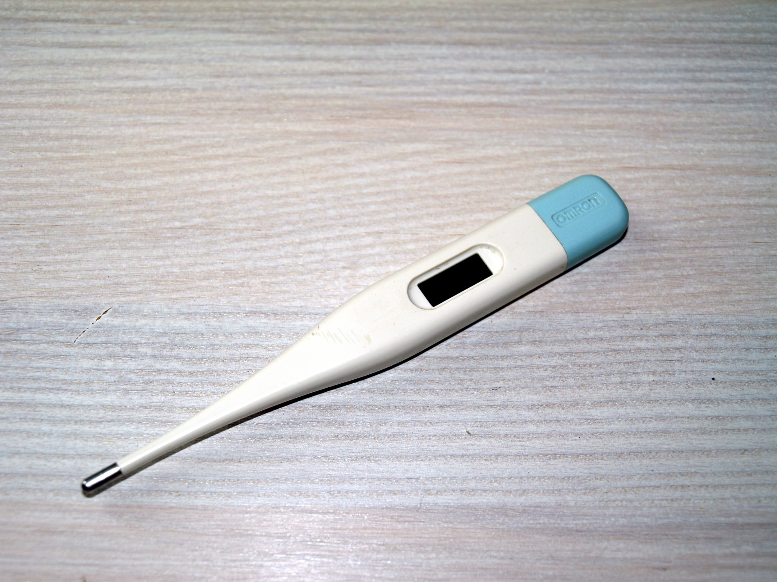
Table Activity: Using these images, decide on the purpose of each assessment and provide a rationale on why.
Notes:
Using these images, as decide the purpose of the assessment and a rationale on why.

Slide 61
Assessment “four” a Purpose…
Screening
Diagnostic
Progress Monitoring
Outcomes

Slide 62
Screening
Fast and cheap
Given to everyone (universal)
It’s an “indicator”
Tells you which students might be in trouble
Need to gather more data on these students

Slide 63
Elementary Screening
General Outcome Measures
  Oral Reading Fluency
  Math Facts
  Early Literacy / Numeracy
Computer-Adaptive Tests
  MAP / aReading / aMath / STAR
Attendance
Office Discipline Referrals (ODR)
Engagement Survey

Slide 64
Secondary Screening
General Outcome Measures (CBMs)
  Grades 6-8 (most or all students)
  Grades 9-12 (some students)
Computer-Adaptive Tests
  MAP / STAR
Attendance
Office Discipline Referrals (ODR)
Credits
Grades / Assignment completion
Engagement Survey

Slide 65
Secondary Risk Indicators (1)
Academic indicators
  GPA less than 2.0
  Course Failures
  Behind in Credits
Behavioral/Engagement indicators
  10 or more days absent! (Not 10 – 20%)
  Consistently miss instruction due to behavioral or emotional issues

Slide 66
Secondary Risk Indicators (2)
Behavioral/Engagement indicators
  Psychological or Social disengagement
    Lack of Peer Group
    Lack of Involvement in School Extracurricular Activities
    Low Educational Expectations
    Lack of Personal Relationship w/Adults at School
Retention
  Retained 1+ Years
Mobility
  Multiple Schools during Educational Career

Slide 67
Screening: SEL
Externalizing Behaviors
Internalizing Behaviors
Often a Focus
Office Disciplinary Referrals (ODR’s)
Often missed.
Behavior and Emotional Screening System (BESS) (Kamphaus & Reynolds, 2007)
Strengths and Difficulties Questionnaire (SDQ) (Goodman, 1997)
Systematic Screening for Behavior Disorders (SSBD) (Walker & Severson, 1992)
FASTbridge : SAEBRS

Slide 68

Prediction is critical to Prevention and Intervention:
Reading trajectories are established early: Poor readers at the end of first grade are at very significant risk for long term academic difficulty (Juel, 1988)
Measurement tools that help predict risk status for later academic outcomes are vital to ensure that resources are distributed appropriately and to intervention is making a difference.
Screening data:
  Often helps the system verify that children that are on benchmark, stay on benchmark.
www.oakland.k12.mi.us

Slide 69
Diagnostic
More Detailed & Lengthy
Examination Strengths & Weaknesses

Slide 70
Diagnostic Examples
Measures of Academic Progress (MAP)
PRESS (elementary)
EdReady (secondary)
Specific skill mastery assessments
  Make sure they match instructional scope & sequence (standards)
Engagement surveys
In literacy, should line up with the big 5:
  Phonemic awareness, Phonics, Fluency, Vocabulary, & Comprehension

Slide 71
Diagnostic Example
Phoneme deletion and manipulation
Segmenting and blending
Rhyming
What does the Child Need to Learn Next?
Notes:
Clock – replace the c with a b and you get?

Slide 72
Progress
Monitoring
Given repeatedly to an individual over time
Must be efficient & inexpensive
Must be “sensitive” to growth
Directly informs instruction – how well is it working?
Notes:
Sensitive to growth means that, if a student takes the test, and then takes it again a period of time later, any change in their score should be due to growth, not simply measurement error. However frequently you want to measure, that’s how sensitive your progress monitoring tool needs to be. Example: MAP is sensitive to Fall-Spring growth, but not to monthly growth. CBM-Reading is sensitive to growth over shorter periods of time (i.e., monthly).

Slide 73
Progress Monitoring
Examples:
CBM-R (oral reading fluency)
Math Fact fluency
Early literacy / numeracy assessments
Direct behavior ratings
Month-to-month ABC analysis

Slide 74
Progress Monitoring
Non-Examples:
State Accountability Tests(only given once per year)
MAP (only measure growth over longer intervals of time)
Math concepts & applications (not sensitive)
MAZE (not sensitive)
End of unit tests (not consistent)

Slide 75
Outcomes
Summative assessments
Instruction is over.
The “final exam”
Typically given building or district-wide
Used for evaluation

Slide 76
  Check Engine light
  Blood pressure
  MRI
  X-Ray
  Interview w/ Doctor
Screening
Diagnostic
Outcomes
Progress Monitoring
  Final weigh-in
  ACT
  Fuel-level indicator
  Scale
Notes:
Something to connect new information to!
Data vs Questions – same data can answer different questions!

Slide 77
Outcomes
Examples:
State Accountability Tests
California Smarter Balanced Assessment Consortium (SBAC)
College readiness tests (ACT, SAT, Accuplacer)
Can be other assessments, as well (i.e., NAEP, MAP, etc.)
Can be other outcomes (i.e., Graduation Rates)

Slide 78
The Data Literacy Remedy
Data Literacy Discussion Guides for PLC’s
1-Page Fact Sheets organized around each purpose of assessment
For use in PLC discussions

Slide 79

79
How Aligned is your Assessment System?
Do You have a Shared Understanding?
Do You Understand Why You Use the Tools You Use?

Slide 80

Assessment Inventory
Can your building understand the purpose of assessment for the tools that they are required/optional tools?
Ask yourself:
Do you have too many assessments?
Do you have too many in one area & not enough in another?

Slide 81
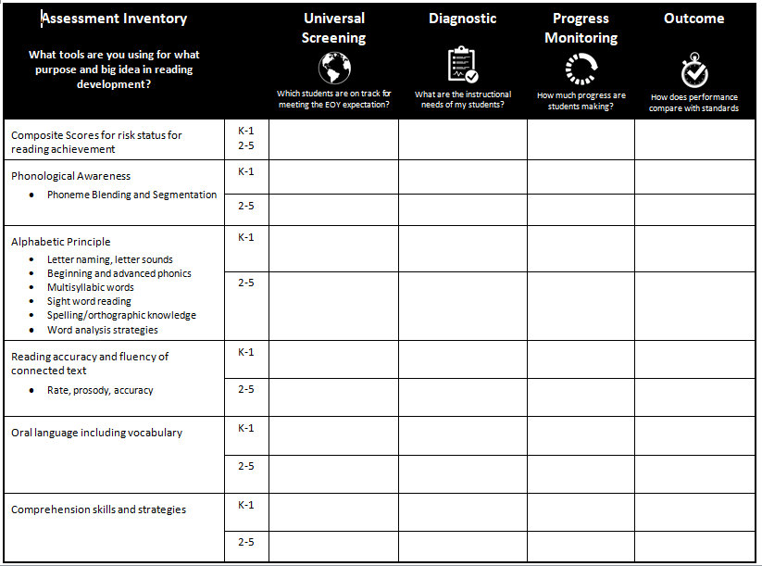
See Resources: 2019-20 Assessment Inventory

Slide 82
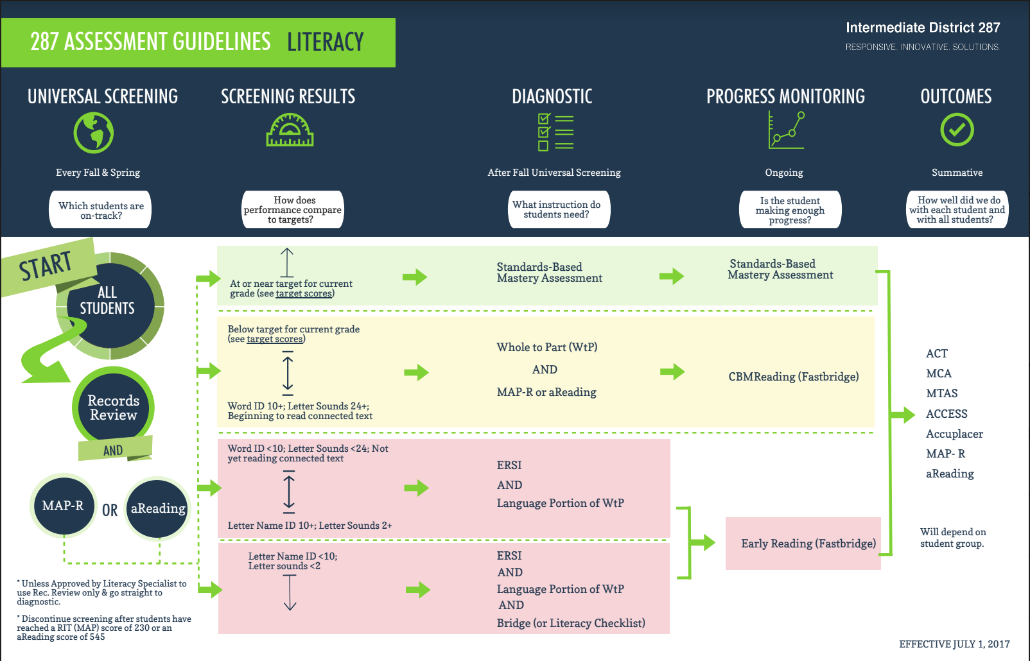

Slide 83
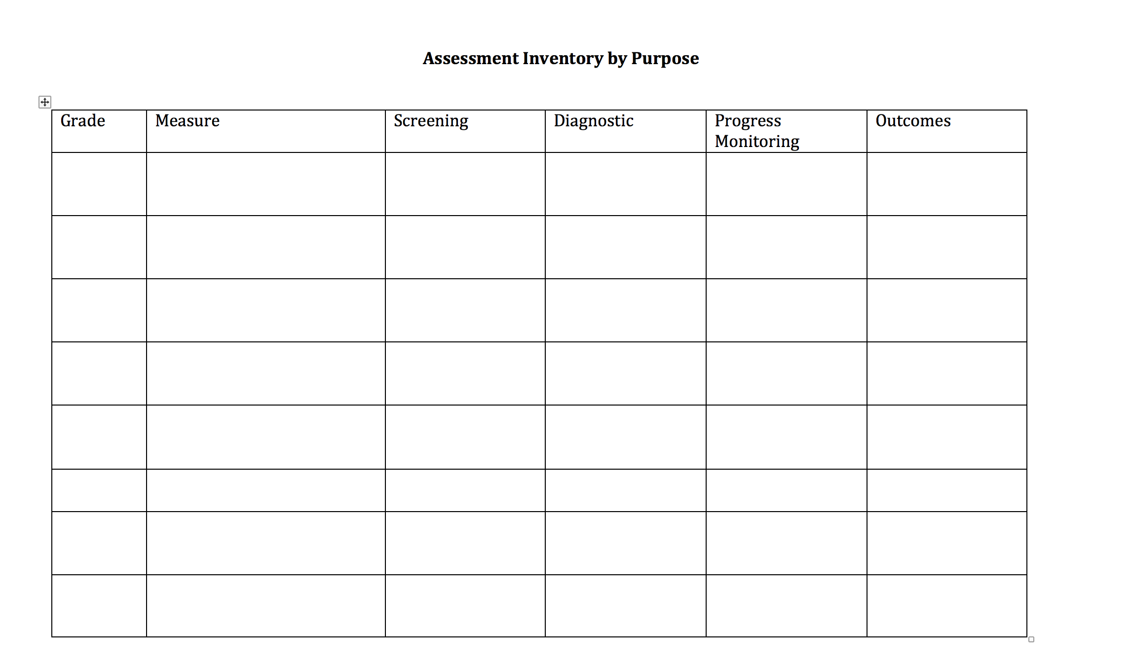

Slide 84
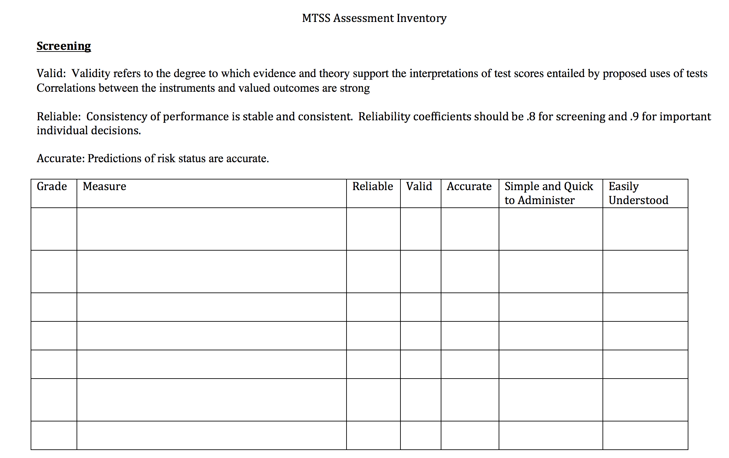

Slide 85
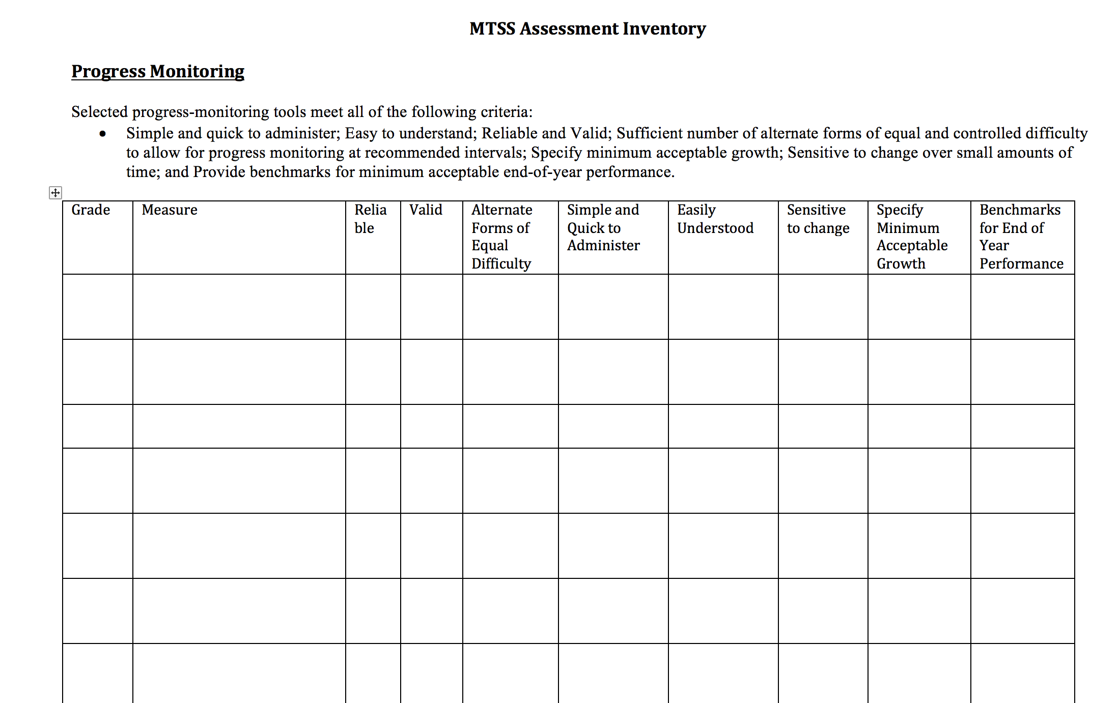

Slide 86

Resources for Your Team
Center on Response to Intervention Screening Briefs
Center on Response to Intervention Progress Monitoring Briefs
In-depth inventory tool:
http://www.achieve.org/assessmentinventory

Slide 87
Quick Chat
What assessments are available to you at each grade level? Thinking about the four purposes of assessment, are there any gaps or redundancies in your current assessments?
To what extent do you have a high degree of data literacy in your building?
Review data literacy guides. Could these be a resource?

Slide 88
Big Idea #4
A Decision Making Model is Critical

Slide 89



Data-Based Decision Making
Process
Data System
Responsiveness

Slide 90
Data-Based Decision Making
Process
Data System
Responsiveness
Decisions we make about students should be data-driven, involve teams and have clear sets of rules.

Slide 91

What is expected?
When reflecting on current data, you first have to know what your expectation is.
What is the expected performance?
This work involves making comparisons.

Slide 92
Comparisons: 80% Based on What?
Norm-Based: Comparison to others to allow for sorting and ranking.
  Local Percentiles
  National Percentiles
Criterion-Based: Comparison to a pre-determined target to determine mastery of specific objectives.
Self: Comparison to self at a previous time.

Slide 93
Norm-Based: Example
National Norms
  Using national norms to evaluate the percentage of students on-track.
  NWEA MAP Score - 40th percentile for Reading RIT is a score of 204 in Grade 5.
Local Norms
  Useful for resource allocation
  Rank order of scores locally with percentiles.

Slide 94
Development of Target Scores
Logistical regression procedures used to predict performance on MCA-II
Tier 1 and Tier 2 Targets Developed

Slide 95
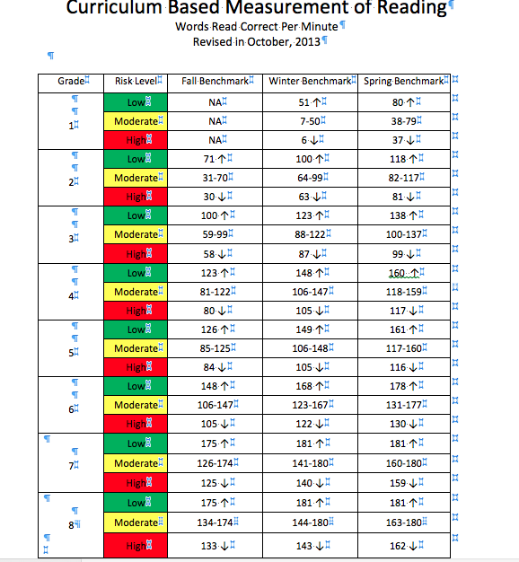

Slide 96
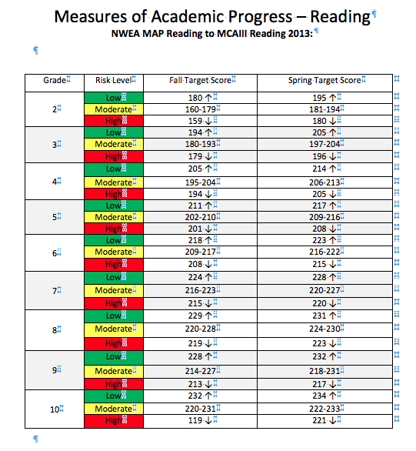

Slide 97
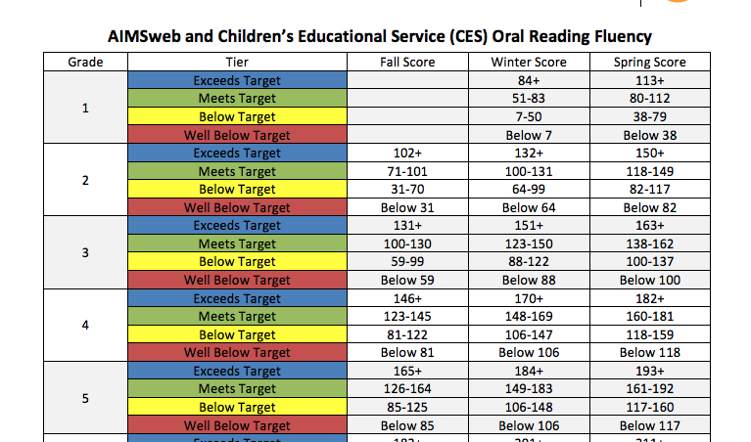
Another Criterion-Based Example: TIES
Exceeds Target – Predicts a score of 24 on ACT.
Meets Target – Approximately 90% of students scoring in this range are predicted to meet standards MCA-III
Below Target – Approximately 50% of students scoring in this range are predicted to meet standards on the MCA III.
Well Below Target – Approximately 10% of students scoring in this range are predicted to meet standards on the MCA-III

Slide 98
Caveats and Cautions
Understand what type of criterion you are using!
NWEA MAP RIT Reading Grade 5
 | RIT Score | Percentile
Norm-Based | 204 | 40th
Criterion-Based | 211 | 62nd

Slide 99
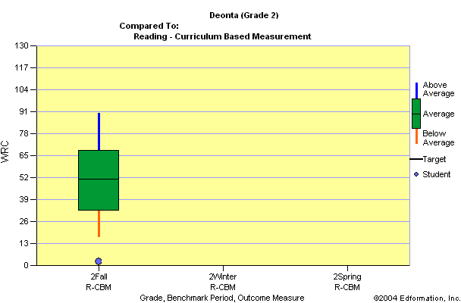
Schools Use GOM in Universal Screening Instead of Referral Driven Practices
< 25th
Tier 2 Candidates
<10th
Individual Problem Solving and/or
Tier 3 Candidates
Notes:
99
Students below the 25th could be automatically considered for Tier 2 Interventions
Students below the 10th percentile could automatically be considered for Problem Solving and RTI
Deonta is well below the 10th percentile and should be considered for intensive problem solving and maybe special education for her to benefit from a reading program.

Slide 100
Data-Based Decision Making
Process
Data System
Responsiveness

Slide 101

Data System
Data Summary Charts Created & Accessed by all Teachers.
Protocols for Data Analysis Readily Available for All Teachers.
Database that contains Universal Screening Results from Previous Year & Summarized Data from Other Years.
Notes:
Discuss which of these you already do. Which will go on a to-do list?

Slide 102
Data-Based Decision Making
Process
Data System
Responsiveness
Make Decisions based on reliable & valid data that
reflect student progress (or slope) toward the
ultimate goal and implement accurately.

Slide 103
Decision-Making Rules
Helps people who review data decide when a change in instruction is necessary.
Helpful terms:
  Level (Current Performance)
  Slope (growth rate or improvement)
  Aimline (Expected growth)
  Trend line (Actual growth)
Notes:
103

Slide 104
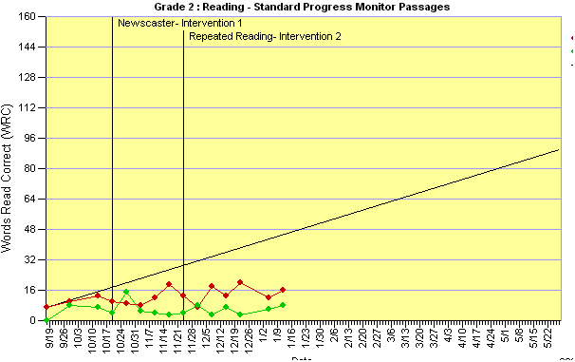

Slide 105
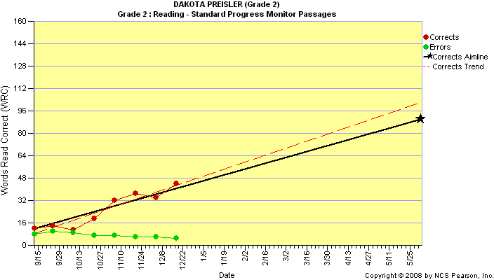

Slide 106

Documentation of Process is Critical
Must have a clearly defined process
Forms and guidelines to guide process
Start out with “tight reigns”
  SCRED oversight of referrals
  Problems with documentation
Notes:
Holly

Slide 107
Action Item: Take Stock!
Do you have a written MTSS guide that is used for training and support?
  Operationalized decision-rules
  Definition of Tiers
  Types of teams
  Decision-making protocols?
  Evaluating responsiveness to intervention
Do you have a data system that is easy to use and makes the team work more efficient?

Slide 108
Big Idea #5: Don’t Ignore Unviversal Instruction!

Slide 109
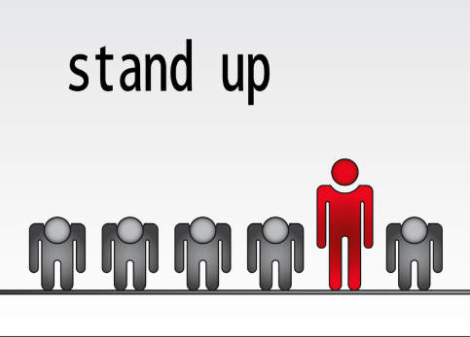
Pop-Up: How do you define universal instruction?
Tell the person next to you how you define universal instruction.

Slide 110
Why Focus on Core Instruction?
Most efficient use of school resources
All students receive effective instruction: proactive & preventative
Inadequate instruction is eliminated as a reason for low performance
Core programming that includes periodic screening identifies students who are struggling academically and may need more differentiation.

Slide 111

The Relationship Between MTSS & the Book
Many Districts around the country are Implementing MTSS.
Effect Size of MTSS on Student Achievement is Large when Implemented w/Fidelity (d=1.09).
Many Districts begin Implementation Focusing on Tier 2 & Tier 3.
1st step - Evaluate Effectiveness of Universal Instruction (T1).
Why This Book ?

Slide 112
Core Instruction Tier 1
Research-Based Curriculum
Articulation of Teaching and Learning Standards
  Within Grade Levels
  Across Grade Levels
Standards Based
Differentiated Instruction
Exceeding Benchmark

Slide 113
Goal for a Strong Core
To create a core instructional program that results in about 80 percent of students meeting grade level expectations without additional support
At least 95% of students who begin the year at grade level expectations will end the year (begin the next year) at grade level expectations
  Utilizing evidence based materials and instructional techniques
  Utilizing personnel and time resources creatively and wisely

Slide 114

It is Impossible to Intervene Your Way Out of a Problem w/Universal Instruction!
Lack of Resources
Band-Aid vs. Genuine Solution
Reactive vs. Proactive

Slide 115
Embedding an Action Planning Process into the Work
Is universal instruction effective?
If UI is not sufficient, what needs must be addressed?
How will the needs identified be addressed?
How will the effectiveness and efficiency of UI be monitored over time.
Have improvements to UI been effective?
SOLUTIONITIS

Slide 116
Quick Chat: Tier 1

Slide 117

Big Idea #6: We have an URGENT need for Powerful Instruction and Interventions Across Tiers of Service

Slide 118

If All You Have is a Hammer,
Everything Starts to Look Like a Nail

Slide 119
If All a Teacher Has for Support for Students with Academic and/or Behavioral Needs
is Special Ed
Every Student with Academic and/or Behavioral Needs Will Look Like a.......

Slide 120
This is what we had…
Special Education
General Education
Amount of Resources Needed To Benefit
Sea of Ineligibility
Severity of Educational Need or Problem
Notes:
120
This is what we had…without problem solving, we were unable to support

Slide 121
Problem Solving Approach
Special
Education
General Education
With Support
Amount of Resources Needed To Solve Problem
General
Education
Intensity of Problem
Notes:
121

Slide 122

Successful Multi-Tier Models Have:
Continuum of services and/or programs across tiers that are scientifically based
Methods of evaluating & monitoring progress across tiers, ideally those considered scientifically based
Efficient, COMMON methods of communicating student performance for all disciplines.
Notes:
122

Slide 123
Defining Tier 2 Instruction
Interventions are:
evidence-based,
standardized,
well-aligned with core instruction and incorporate foundational skills that support learning objectives of core instruction.
led by staff who are trained in the intervention,
designed to have optimal Group size and dosage for the age and needs of the student.
supplemental to core instruction.

Slide 124
Tier 2 is “MORE”
(More) Time
(More) Explicit Teacher-Led Instruction
(More) Scaffolded Instruction
(More) Opportunities to Respond with Corrective Feedback
(More) Language Support, Especially Vocabulary
(More) Intensive Motivational Strategies
(More) Frequent Progress Monitoring
Must have systems in place that allow movement in and out.
Notes:
124

Slide 125
As the magnitude of the problem increases...
The required resources to address the problem increases
The need to enhance environmental structures increases
The frequency for collecting and acting upon information increases
Intensity of Supports
Notes:
125
125
125

Slide 126
Secondary Practices for
Tier 2 Intervention
Class size. The student-teacher ratio was ~ 10–15:1
Schedule. Interventions often occurred during electives or an already existing “flex” class period.
Delivery. General education teachers most frequently taught the intervention classes, but some schools reported a combination of general educators, special educators, and specialists.
Frequency. Most students received interventions daily.
Duration. Most interventions were a class-long session (typical time was 44 minutes).
Notes:
When screening scores indicated that a group of students was not meeting the school’s predetermined levels of proficiency, those students received more intensified instruction in secondary-level interventions. Secondary-level instruction is delivered to those students identified as needing additional academic instruction. For example, these are the students that your data show are struggling to meet your standards and need additional instructional support.
Some of the middle schools intensified secondary-level instruction in several ways:
Smaller class sizes for specialized classes (e.g., a 1:10 teacher/student ratio)
Homogenous classes of students with similar instructional needs
Expert teachers prepared to deliver instruction in the specific areas of concern
Frequency and duration of instruction increased
All middle schools scheduled their secondary level of intervention in place instead of an elective class. These interventions often occur daily and consist of small groups of students with similar instructional needs.
In secondary-level interventions, many schools also used standard protocols, (i.e., research based, validated, prepackaged, scripted instructional programs for reading and mathematics). Most schools had a menu of standard protocols from which to choose when determining students’ instructional needs. As one principal stated, "We try, at our [secondary level], to put our students in cohorts as best we can with similar deficiencies, or areas of weakness, so that we can really target instruction."
In many middle schools, a general education teacher taught secondary-level intervention classes during elective class time for a full-class period. Some schools offered classes in a block framework, wherein classes met every other day for a longer period of time (e.g., 1½). Other schools were able to hire interventionists, whose sole job was to teach the more intensive classes. No matter the background of the instructor, all teachers of intervention classes were specifically prepared to teach the intensive instructional methods.
At this point, you probably are wondering how to fit in extra classes in an already packed schedule. We’ll offer some ideas in a moment.

Slide 127

Secondary Examples
Check and Connect
Homework Lunch Intervention
Reading intervention elective period
Math intervention elective period
  Transmath

Slide 128

Quality Components of Tier 3

Slide 129

Intensive Interventions Defined:
Instruction provided to a few students (in addition to core instruction) who need significant differentiation and greater intensity in their instruction.
Intensive Intervention does NOT equal Special Education
Notes:
129
Intensive interventions are designed to address severe and persistent learning or behavior difficulties. These interventions are characterized by increased intensity (e.g. smaller group, expanded time) and individualization of instruction and behavioral intervention for students who have been non-responsive to traditional approaches.

Slide 130

Work on the Right Problem!

Slide 131
Steps of Problem-Solving
1. Problem
Identification
What is the discrepancy between
what is expected and what is occurring?
2. Problem
Analysis
Why is the problem occurring?
3. Plan
Development
What is the goal?
What is the intervention plan to address this goal?
How will progress be monitored?
5. Plan
Evaluation
Is the intervention plan effective?
4. Plan
Implementation
How will implementation integrity be ensured?
Notes:
131

Slide 132

Tier 3: Intense Intervention
Matched to student needs
Optimal group
size and dosage
Delivered by
trained staff
Relationship to
grade-level
standards
Tier 3
Tier 2
Tier 1

Slide 133
Students Requiring Intensive Instruction
(Most) Time
(Most) Explicit Teacher-Led Instruction
(Most) Scaffolded Instruction
(Most) Opportunities to Respond with Corrective Feedback
(Most) Language Support, Especially Vocabulary
(Most) Intensive Motivational Strategies
(Most) Frequent Progress Monitoring

Slide 134
How Intense is the Intervention?
Considering Defining Factors
More intensive instruction may include:
  More in-depth assessment if necessary
  More precisely targeted at right level
  Smaller instructional groups
  More instructional time (frequency and/or length)
  Clearer and more detailed explanations
  More extensive opportunities for guided practice
  Higher rates of responding
  More opportunities for error correction and feedback
  Higher rigor
  Increased expertise of interventionist

Slide 135
What Could We Change?
Focus or skill
Teaching strategies: More explicit, more modeling, more practice, more previewing, better matched with core
Materials: Easier, better matched (cultural, interests, etc.)
Arrangements: Size group, location, who is teaching?
Time: Amount of time, days per week, time of day
Motivation: Interests, goals, rewards, home/school
135
Notes:
Could use any basic teaching best practices framework here to help you decide what to change…. BUT HAVE A FRAMEWORK and USE IT!

Slide 136
Highly Effective Practices (Hattie, 2009)
Teaching
  Formative Evaluation (d = .90)
  Comprehensive Interventions for L.D. Students (d = .77)
    Direct Instruction (d = .59) + Teaching Strategies (d = .60)
  Feedback (d = .73)
  Spaced vs. Mass Practice (d = .71)
  Meta-Cognitive Strategies (d = .69)
  Self-Verbalization/Self-Questioning (d = .64)
Teacher
  Teacher Clarity (d = .75)
  Teacher-Student Relationships (d = .72)
Curricula
  Vocabulary Programs (d = .67)
  Repeated Reading Programs (d = .67)

Slide 137
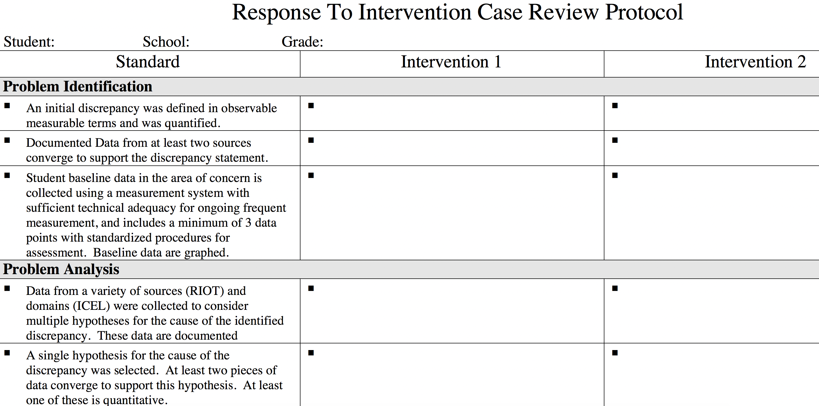
Case Review Protocol: Problem Solving Model

Slide 138

The Importance of Inventories
        Does your building have a accurate inventory of curriculum and intervention strategies across tiers?
        Has the inventory been shared with all staff
        What work remains to be done?

Slide 139
Think-Pair-Share
  Self-Assessment
What are your strengths and opportunities for Tier 2-3?
Fidelity Rubric
Multi-Level Instruction
When to do this with your team?
What work remains to be done in this area?
Notes:
139

Slide 140

Big Idea #7: Collaboration and Teamwork are Essential.

Slide 141

Consider Nested Teams to
Support MTSS Implementation
A District-Level MTSS Team
to make things happen for the district
A Building Leadership Team to make things happen for the school
Grade-Level or Core team
w/support to make things happen for groups of students
A Problem-Solving team
to make things happen for individual students

Slide 142
Action: Take Stock!
Conduct an inventory of teams. Work smarter not harder!
Team Inventory
Roles and Responsibilities

Slide 143
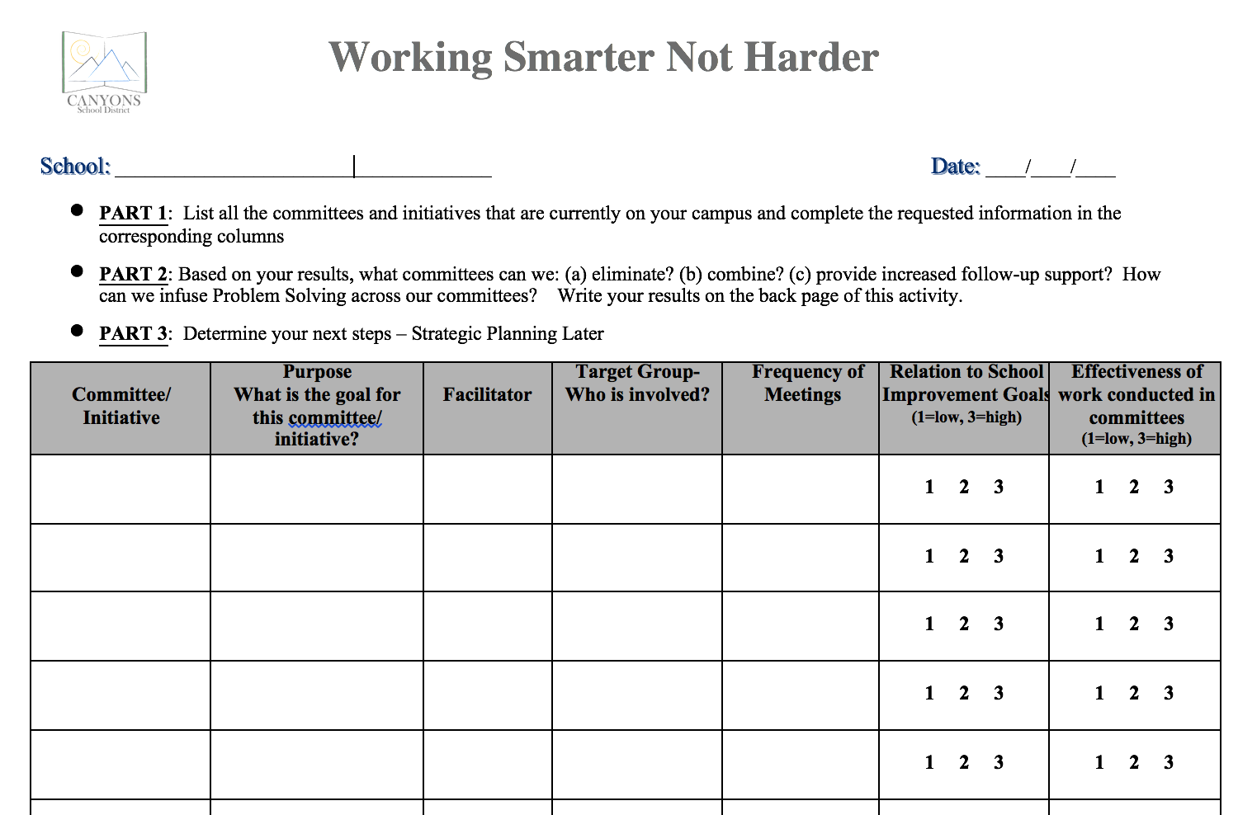

Slide 144
2 Minute Discussion
Do you have too many teams, not enough, or just the right amount?
How effective and efficient are your teams?
Would an inventory of teams be helpful?

Slide 145
Big Idea #8: Treatment Integrity is not a “Maybe.”
This is the topic of this afternoon!

Slide 146
Fidelity of Implementation
Fidelity of District and Implementation Plan
Fidelity of Core Instruction
Fidelity of Interventions
  Intervention Scripts (checklists)
  Direct Observation
Fidelity of Frequency and Intensity of Interventions
Fidelity of Progress Monitoring

Slide 147

Big Idea #9: Special Education Should Be

Slide 148
What is DIFFERENT once a student qualifies for Special Education?

Slide 149
Important Questions
How often do we continue implementing ineffective interventions?
How do we intensify interventions?
How do we match interventions to student needs?
How do we ensure that effective instructional practices are being used that will accelerate learning?

Slide 150
Instructional Match is Critical
Matching interventions to skill deficit
  Problem Analysis is critical!
  Can’t do vs. won’t do
  Reading: 4-Box Sort
  Math: Conceptual vs. Procedural
  Behavior: FBA
Matching intensity to need
  Time and frequency
  Use common sense!

Slide 151
National Consensus that Special Education (Still) isn’t “Special”
…an important cause of SWD’s abysmal academic achievement in the elementary grades and in high school is that schools fail to provide sufficiently intensive instruction—not because they willfully withhold it, but because they fail to recognize a need for it, and they have lost the know-how to provide it.
There needs to be renewed focus on intensive intervention…
Fuchs, D., Fuchs, L. S., McMaster, K. L., & Lemons, C. J. (2018). Students with disabilities abysmal school performance: An introduction to the special issue. Learning Disabilities Research & Practice, 33, 127-130.

Slide 152
National Consensus that Special Education (Still) isn’t “Special”
Special education services currently are insufficient to fulfill IDEA’s promise of a free, appropriate public education for all students with LD. In our view, this situation exists because the focus on providing intensive, data-driven, student-focused, individualized instruction has been lost…
Co-teaching seems to support the egalitarian aims of inclusion, but the data on student achievement in co-taught classrooms are very limited… To date, there are still no data that support causal inference—that is, that co-teaching leads to improved outcomes for students with disabilities.
Lemons, C. J., Vaughn, S., Wexler, J., Kearns, D. M., & Sinclair, A. C. (2018). Envisioning an improved continuum of special education service for students with learning disabilities: Considering intervention intensity. Learning Disabilities Research & Practice, 33, 131-143.

Slide 153
SLD Eligibility within an MTSS Framework

Slide 154
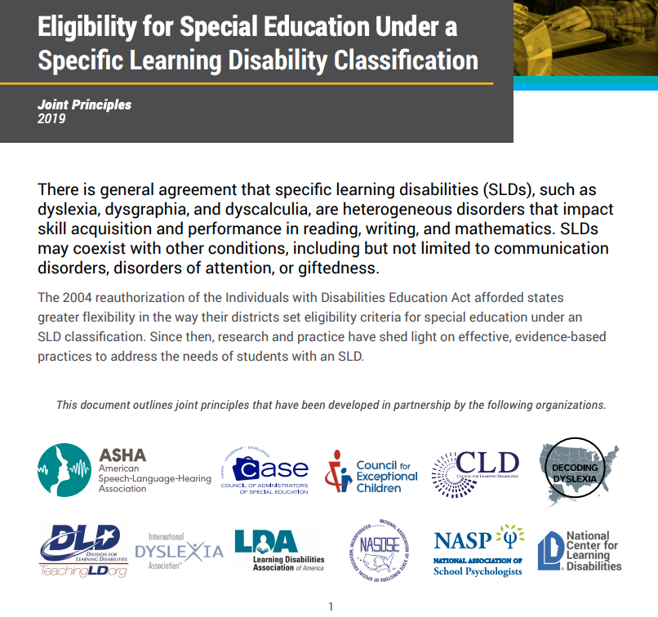
Joint Principles Developed in Partnershipi with:

Slide 155
Special Education and MTSS Entitlement
Instead of IQ/Achievement Discrepancy:
  Problem solving teams will design powerful interventions for students following the 5-step problem process
  Regular data collection
  Students will be eligible to receive special education services when data a discrepancy on both level and slope of performance
  Exclusionary Factors
Notes:
155
Kim

Slide 156


Average Achievement of Peers
Performance Discrepancy: Severe Educational Need
A Significant Performance Discrepancy, is Necessary, But Not Sufficient
Student with Concerns
Adapted from Fuchs, 2003
Notes:
\

Slide 157
How to Measure the Performance discrepancy?
Measuring the Performance Discrepancy is the EASIEST Thing to Do.
Use a Validated, Norm-Referenced Achievement Test, But Be Attentive to Issues of
  Are National Norms Representative of the Community Where Students Go to School? If Not, Local Norms Are Essential!
  Do You Want a Seamless Assessment System or “Separate” Assessment System

Slide 158
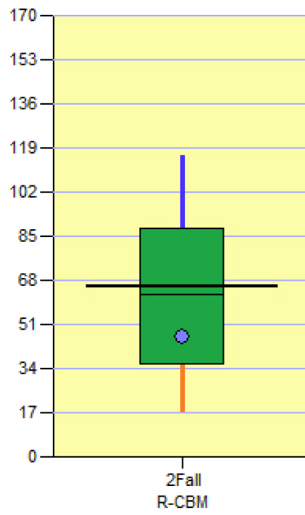
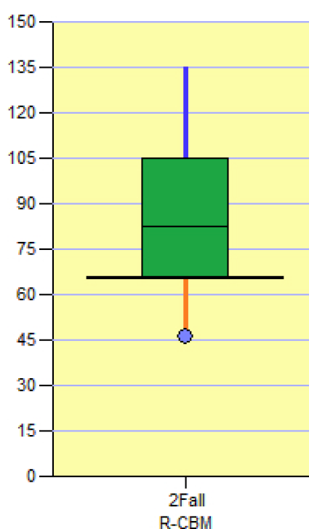
Norms Matter when Determining the performance Discrepancy
No Significant Performance Discrepancy
Significant Performance Discrepancy
Average Reader Nationally
  34th Percentile
Significantly Discrepant Reader Locally
9th Percentile

Slide 159
Use of Local Norms
Standard 12.5.
Local norms should be developed to support test users’ intended interpretations.
Comment: Comparison of examinees’ scores to local as well as more broadly representative norms can be informative. Thus, sample size permitting, local norms are often used in conjunction with published norms, especially if the local population differs markedly from the population on which the published norms are based. In some cases, local norms may be used exclusively.
(p. 196)
American Psychological Association, American Educational Research Association, & National Council on Measurement in Education. (2014). Standards for educational and psychological tests. Washington, DC: American Educational Research Association.

Slide 160

Mark Shinn’s Cut to the Chase Perspective
If Local Norms and National Norms Don’t Differ, Use the Norms that Work Best to Communicate.
IF They Differ, Use Local Norms as the PRIMARY Decision Making Metric. It’s How Teachers and Parents “Think” About Problems. It’s Straight. No Mental Gymnastics Required.
Local Norms Reflect a Real Distinction of What is a General Education Problem for Many Students and the Few Who May Require a More Intensive Intervention.
DON’T BE SCARED! IT’S GOOD PROFESSIONAL PRACTICE!

Slide 161
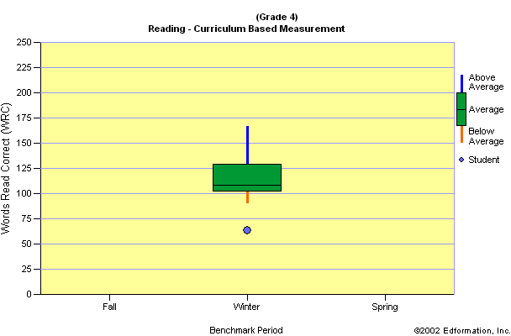
A Severe performance Discrepancy
Severe Educational Need
Consider Tier 3 ASAP

Slide 162
Critical SLD Eligibility Component: Progress Discrepancy
PROGRESS DISCREPANCY
How a Student’s RATE OF IMPROVEMENT (ROI) Compares to the the EXPECTED LEVEL ROI of Achievement, Norm-Based or Standards-Based

Slide 163
Likely NOT ELIGIBLE
Average Achievement of Peers
Performance Discrepancy: Severe Educational Need
Progress Discrepancy:
Educational Benefit (Lack of Adequate Progress or Rate of Improvement-ROI)
Student with Concerns
Adapted from Fuchs, 2003

Slide 164
Average Achievement of Peers
MAY Be Eligible
Performance Discrepancy
Progress Discrepancy
Student with Concerns
Adapted from Fuchs, 2003

Slide 165
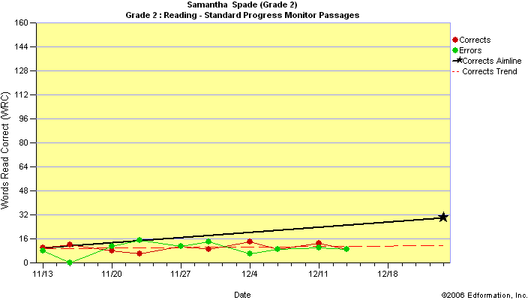
CBM Is a useful tool TO MEASURE THE PROGRESS DISCREPANCY
Expected ROI to Significantly Reduce the Gap
Actual ROI NOT Reducing the Gap
Notes:
This student is NOT “responding” to the intervention and would require a modified intervention or consideration of an IEP for the student to benefit in reading.

Slide 166
Putting the Concepts Together
A Severe Performance Discrepancy
A Severe Progress Discrepancy
+
=
Performance Discrepancy
Progress Discrepancy
Dual Discrepancy

Slide 167

CURRENT PRACTICES
In Special Education
Content Area Courses
Student Doing Poorly in Social Studies
Student Receives Homework Help, Accommodations (Extended Time, Modified Grades) or “Alternative” Social Studies with Lower Content and Reduced Expectations

Slide 168
The performance Discrepancy is in Basic Skills That Require Intervention
Intensive Basic Skills Intervention
Student Doing Poorly in Social Studies
TREAT
Severe Basic Skill Discrepancy
Low Basic Skills
Content Area Support Accommodations
SUPPORT

Slide 169
RtI as SLD Identification Grades 9-12
Students May Be Eligible for Special Education under the Category of SLD Grades 9-12 IF:
  Severe Achievement Discrepancy Below the Median of Local End-of-Year Grade 7 Students as Measured By CBM Using Grade 7 Tests (a Standards-Based approach)—Use Confidence Intervals and Don’t Get Rigid on the Cutscore
  Severe Progress Discrepancy—Progress On CBM is Below the Rate of Improvement (ROI) That Significantly Reduces the Severe Achievement Discrepancy When
      Tier 3 Intervention is of Appropriate Intensity
      Delivered With Fidelity
  The Proposed Special Education Intervention Has a Direct Instruction, Basic Skills Focus that is Described in Sufficient Detail to Suggest that is Different in Meaningful Ways from Tier 3 Intervention and Reflects Specially Designed Instruction to Meet the Student’s Unique Needs
  All Other Procedural Requirements (Determinant and Exclusionary Components) Have Been Addressed

Slide 170
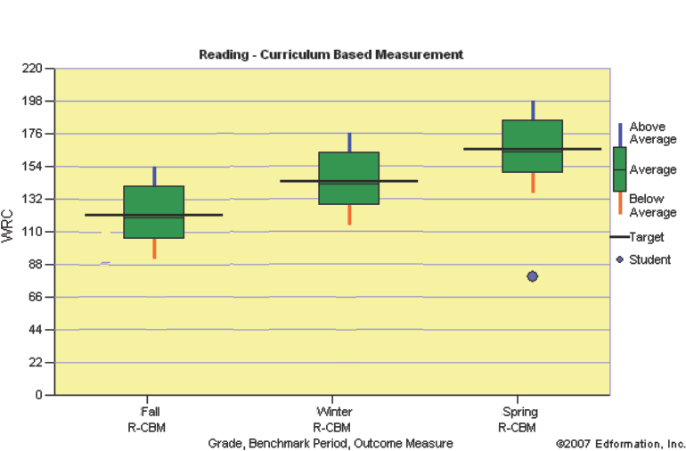
Grade 9-12 SlD Performance Discrepancy
End-of Grade 7 Minimum Reading Proficiency Standard
Student Performance Significantly Discrepant from End-of-Grade 7 Standard

Slide 171
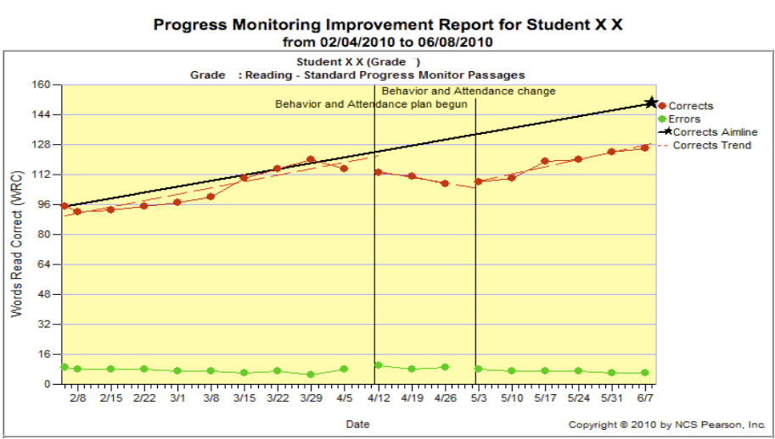
Measuring The High School Progress Discrepancy
Actual ROI NOW Reducing the Gap
Expected ROI to Significantly Reduce the Gap
Notes:
This student is NOT “responding” to the intervention and would require a modified intervention or consideration of an IEP for the student to benefit in reading.

Slide 172
Filter (2007) Survey Results – Top 3 overall areas of need for training
Curriculum based assessment/measurement
One-on-one counseling
Prevention screening

Slide 173

Barriers
Lack of Administrative Support for a Changing Role?
Too large of a student population covered?
Building and/or District Staff lack of understanding of your role?
Lack of capacity within your “teams”
Lack of skills to operate in a new paradigm?

Slide 174

Carve out your niche
Don’t wait for other people to change your role
Be proactive
Find your friends
Make yourself indispensible
Build the capacity of your team
Develop your skills around data- utilization at all levels (district, building, grade, classroom, individual student)
Be a leader
Notes:
Volunteer
Administrators are used to the services they have gotten.

Slide 175

Student Population
Understand your district and building needs
Start talking about needs often and early
School budgets are being formed January – March for the following year
Propose a solution that adds value (i.e., builds on identified needs)
Are there things you are currently doing that could be done by other people?

Slide 176

Lack of Capacity within Your Teams
Communicate with your administrators
Identify areas of need for continuing professional development
When you consult, work on building capacity and teaching rather than “doing it all.”
Volunteer to assist with in-service training

Slide 177

Understanding of your Role
People typically expect the services they are used to receiving
“Teach” about your role by your actions and your words
If you are new to your building, talk to your principal about a short presentation at a faculty meeting about what staff can expect from you
Work very hard on building relationships

Slide 178
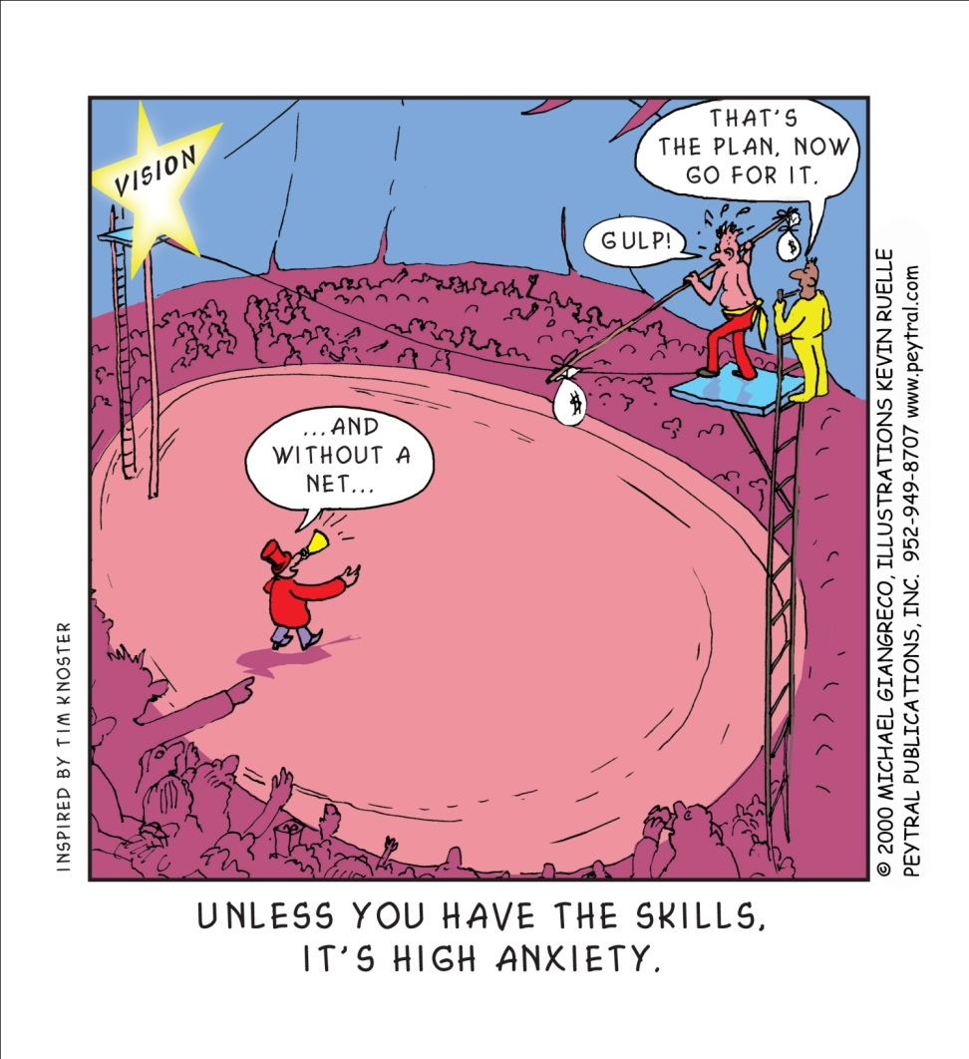
Lack of Skills?
Skill Building
Resistance is often Anxiety
Form a monthly book study with other school psychologists
  Best Practices
  Interventions Book
  NASP Website
  Other?
Set a weekly or monthly reading goal
  Marshall memo, School Psychology Review, Assessment for Effective Intervention, Exceptional Children, other?
Be on the look-out for free or low-cost webinars
Join a community of practice or discussion board and participate regularly

Slide 179
Closing Activity
Tell your neighbor three things you plan to share with your building team regarding the content this morning?

Slide 180

What’s Next?
Is Change Necessary?
“Insanity is doing the same thing over and over
and expecting a different result.”
—Albert Einstein

Slide 181

The Moso Bamboo Tree
The Moso bamboo plant grows in China & the far east. After the Moso is planted, growth occurs slowly for up to 5 years - even under ideal conditions! Then, as if by magic, it suddenly begins growing at the rate of nearly 2 ½ feet per day, reaching a full height of 75 feet within 6 weeks.
But it's not magic. The Moso's rapid growth is due to the extensive root system it develops during those first five years, five years of getting ready.

Slide 182

Kimgibbonspersonal@gmail.com

