Slide 1
Key Drivers for Improving Secondary Outcomes for Students with Disabilities: A Longitudinal Predictive Model
Data Use & Decision-Making | Graduation | Dropout | College Enrollment
MDE Office of Special Education
Michigan Association of School Psychologist Fall Conference – November 8, 2019
Prepared by:
Jerry Cullum, PhD Education Research Consultant
cullumj@Michigan.gov

Slide 2
What Might Be The Consequences of Suspending Students on High School Outcomes and Beyond?

Slide 3
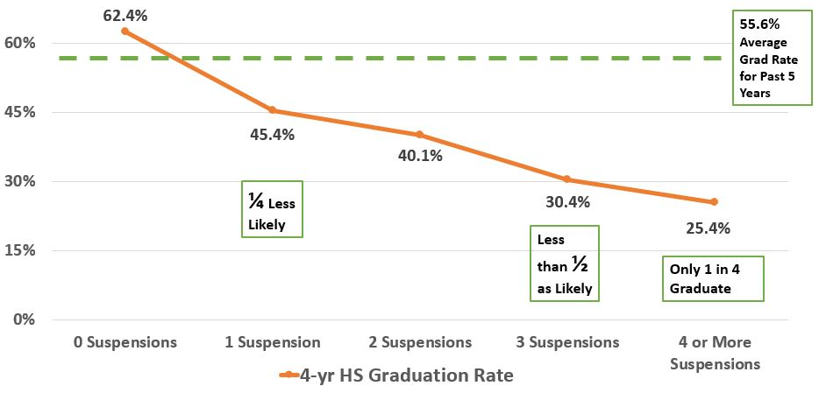
Graduation Rate for SE Students X Number of Suspensions in 9th Grade
Notes:
We begin by looking at 9th grade suspension rates for Special Education students from school year 2011-12, and track their progress after 4 years of high school to see what portion are graduating on time. For the past 5 years, the average 4-year graduation rate for Special Education students in Michigan is 55.6%. Students with no out-of-school suspensions in 9th grade later graduate at an above average rate of 62.4%, while students who received a single out-of-school suspension later graduate at a below average rate of 45.4%, with each additional out-of-school suspension resulting in still further declines in the likelihood of graduating after 4 years of high school. While receiving just 1 out-of-school suspension is enough to reduce the odds of graduating by a quarter (from 62% to 45%), students with 3 suspensions are half as likely to graduate (declining from 62% to 30%) as students with no suspensions in 9th grade. And students with 4 or more suspensions in 9th grade are later graduating at a rate of only 25.4% (only 1 in 4).

Slide 4
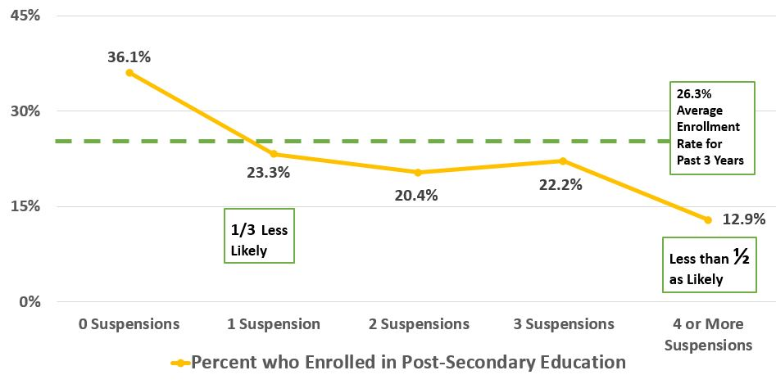
College Enrollment Rate for Former SE Students X Number of Suspensions in 9th Grade
Notes:
Now let’s look at the impact of out-of-school suspensions on post-secondary enrollment. Tracking the same cohort of Special Education students from 2011-12, and now looking at what portion enrolled in college or other higher education training between 4 and 6 years later, we can see if of out-of-school suspensions in 9th grade continue to negatively impact students after high school. For the past 3 years, the average college enrollment rate for Special Education students in Michigan is 26.3%. Students with no out-of-school suspensions from 9th grade later go on to enroll in college at an above average rate of 36.1%, while students who received a single out-of-school suspension later enroll in college at a below average rate of 23.3%, with additional out-of-school suspensions resulting in still further declines in the likelihood of enrolling in college after high school. While receiving just 1 out-of-school suspension in 9th grade is enough to reduce the odds of later enrolling in college by a third (from 36% to 23%), students with 4 or more suspensions are less than half as likely to graduate (declining from 36% to 13%) as students who received no suspensions in 9th grade.

Slide 5
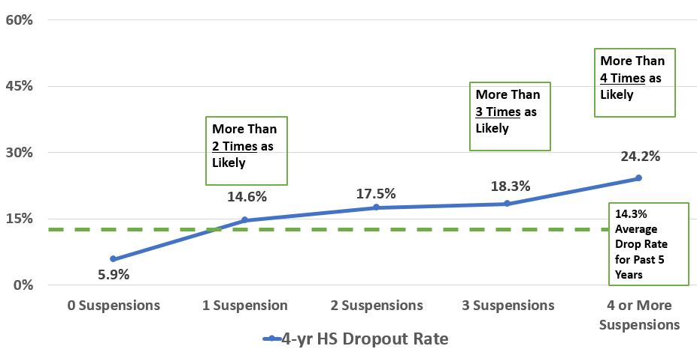
Dropout Rate for SE Students X Number of Suspensions in 9th Grade
Notes:
Now that we have looked at how suspensions reduce 2 positive outcomes for Special Education students, lets look at how out-of-school suspension affect a negative outcome: dropping out of high school. For past 5 years, the average 4-year dropout rate for Special Education students in Michigan is 14.3%. Students with no out-of-school suspensions in 9th grade later dropout at a much-below-average rate of 5.9%, while students who received a single out-of-school suspension dropout at an above average rate of 14.6%, with each additional out-of-school suspension resulting in higher rates of dropping out during high school. While receiving just 1 out-of-school suspension is enough to more than double the odds of dropping (from almost 6% to almost 15%), students with 3 suspensions are more than 3 times as likely to drop out (increasing from 6% to over 18%) as students with no suspensions in 9th grade. And students with 4 or more suspensions in 9th grade are more than 4 times as likely to dropout of high school (6% vs. 24%).

Slide 6
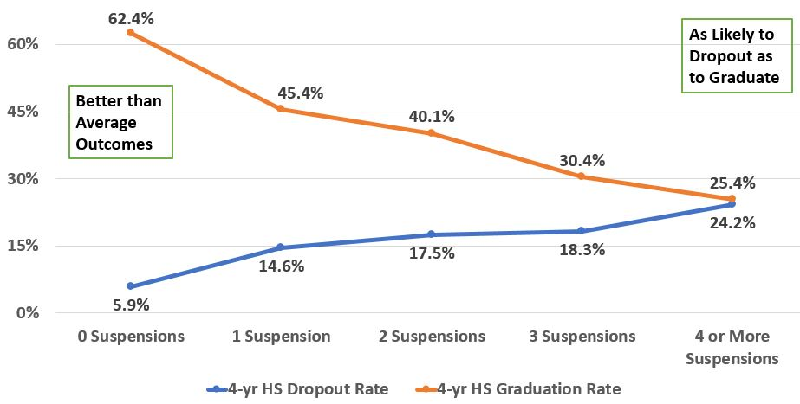
Graduation and Dropout Rate for SE Students X Number of Suspensions in 9th Grade
Notes:
So, what is the overall effect of suspensions on Special Education students? What number of suspensions can a student receive before we start to see worse-than-average outcomes?
In summary, receiving just 1 out-of-school suspension in 9th grade corresponds to worse than average outcomes for students, while students with no suspensions in 9th grade experience better than average outcomes 4 years later. And the outcomes for students get worse with each additional suspension received in 9th grade. By the time a Special Education student receives 4 or more suspensions in the first year of high school, he or she is as likely to dropout out as to graduate.

Slide 7
How Might Attendance Influence High School Outcomes & Beyond?

Slide 8
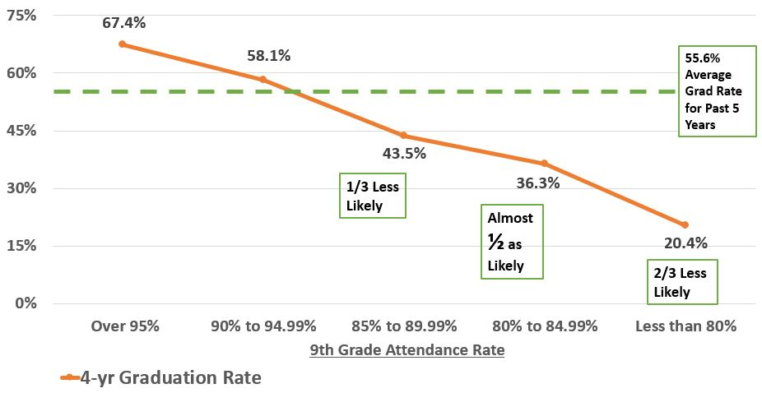
Graduation Rate for SE Students X Attendance Rate in 9th Grade
Notes:
Next, we look at 9th grade attendance rates for Special Education students from school year 2011-12, and track their progress after 4 years of high school to see what portion are graduating on time. For the past 5 years, the average 4-year graduation rate for Special Education students in Michigan is 55.6%. Students who attended 90% or more of the school year in 9th grade later graduate at an above average rate, while students with 9th grade attendance rates of less than 90% later graduate at below average rates. Compared to students with 9th grade attendance rates of 95% or more, students with attendance rates of 89% to 85% were one third less likely to graduate (67% vs. 44%, respectively). Students with 9th grade attendance rates of 80% to 84% were almost half as likely to graduate as their high-attending peers (67% vs. 36%, respectively). And students who attended less than 80% of their 9th grade school year were two-thirds less likely to later graduate compared to their high attending peers (67% vs. 20%).

Slide 9
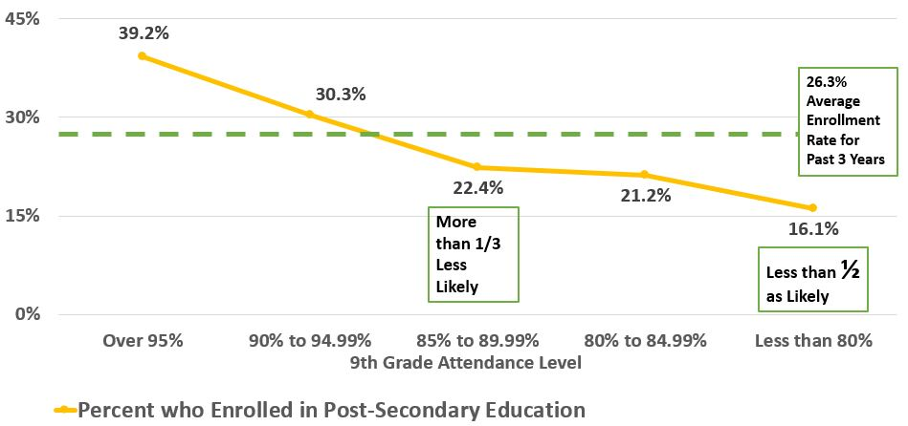
College Enrollment Rate for Former SE Students X Attendance Rate in 9th Grade
Notes:
Now let’s look at the impact of 9th grade attendance on post-secondary enrollment. Tracking the same cohort of Special Education students from 2011-12, and now looking at what portion enrolled in college or other higher education training between 4 and 6 years later, we can see if 9th grade attendance negatively affects students after high school. For the past 3 years, the average college enrollment rate for Special Education students in Michigan is 26.3%. Students who attended 90% or more of the school year in 9th grade later enrolled in college at above average rates, while students with 9th grade attendance rates of less than 90% enrolled in college at below average rates. Compared to students with 9th grade attendance rates of 95% or more, students with attendance rates of 89% to 85% were one third less likely to enroll in college (39% vs. 22%, respectively). Students with 9th grade attendance rates of 80% to 84% were almost half as likely to enroll in college as their high-attending peers (39% vs. 21%). And students who attended less than 80% of their 9th grade school year were less than half as likely to enroll in college within 6 years later (39% vs. 16%).

Slide 10
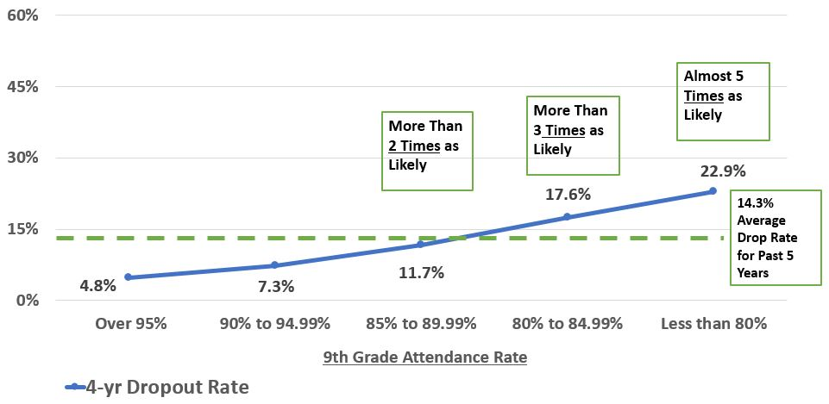
Dropout Rate for SE Students X Attendance Rate in 9th Grade
Notes:
Now that we have looked at how attendance corresponds to 2 positive outcomes for Special Education students, let’s look at how attendance affects a negative outcome: dropping out of high school. For past 5 years, the average 4-year dropout rate for Special Education students in Michigan is 14.3%. Students who attended 90% or more of the school year in 9th grade later dropped out at below average rates, while students with 9th grade attendance rates of less than 90% eventually dropped out at above average rates. Compared to students with 9th grade attendance rates of 95% or more, students with attendance rates of 89% to 85% were more than twice as likely to eventually drop out (5% vs. 12%, respectively). Students with 9th grade attendance rates of 80% to 84% were 3 times more likely to drop out of high school as their high-attending peers (5% vs. 18%). And students who attended less than 80% of their 9th grade school year were almost 5 times as likely to drop out within 4 years (5% vs. 23%).

Slide 11
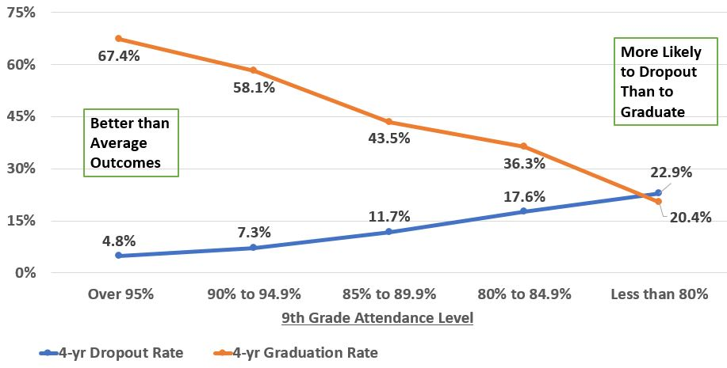
Graduation and Dropout Rate for SE Students X Attendance Rate in 9th Grade - 2
Notes:
So, what is the overall effect of attendance on Special Education students? How much of the school year can a student miss before we start to see worse-than-average outcomes?
In summary, once 9th grade attendance drops below 90%, we start to see worse than average outcomes for students. While students with 9th grade attendance rates experience better than average outcomes 4 to 6 years later, outcomes for students whose attendance drops below 90%, start to grow worse than average, and continue to decline as 9th grade attendance declines. By the time a Special Education student attends less than 80% of his or her 9th grade school year, he or she is more likely to dropout than to graduate.

Slide 12
Other Actionable Key Drivers of Outcomes for Special Needs Students:
Secondary & post-secondary outcomes are also influenced by the following factors that are malleable by Policy & Practice
Personal Curriculum Use | Integration in the General Ed Environment | Assessment Assignments & Curriculum Exposure |

Slide 13
Group Activity
Find Your Data Use Group or Join One

Slide 14
Group Activity Instructions
Review the handout with these questions in mind:
What pattern do you see in the data?
What other data would you want to know or look at?
Based on the pattern of results you see, what actions can be taken to improve student outcomes, at each level:
What actions can the state take?
What actions can the ISD take?
What actions can a district take?

Slide 15
Impact of Personal Curriculum (PC) Use for SE Students
Used PC Did Not Use PC

Slide 16
Impact of Integration in General Education for SE Students

Slide 17
Impact of Assessment Type & Curriculum Exposure for SE Students

Slide 18
Secondary & Post-Secondary Outcomes for Michigan Students with Disabilities
Based on 9th grade behavioral indicators (2011-12 to 2014-15 cohort)
9th Grade Number of Suspensions | No. of Students with Each Characteristic | 4-Year Dropout Rate | 4-Year Graduation Rate | Percent Who Enrolled in Post-Secondary Education | Average Number of Post-Secondary Terms Completed | Average Number of Post-Secondary Course Credits Earned
0 | 11,156 | 5.90% | 62.42% | 36.07% | 3.3 | 22.6
1 | 1,294 | 14.61% | 45.44% | 23.26% | 2.6 | 14.4
2 | 496 | 17.54% | 40.12% | 20.36% | 2.5 | 14.0
3 | 257 | 18.29% | 30.35% | 22.18% | 2.3 | 11.6
4 or More | 418 | 24.16% | 25.36% | 12.92% | 2.3 | 12.1

Slide 19
Secondary & Post-Secondary Outcomes for Michigan Students with Disabilities - 2
Based on 9th grade behavioral indicators (2011-12 to 2014-15 cohort)
9th Grade Attendance Level | No. of Students with Each Characteristic | 4-Year Dropout Rate | 4-Year Graduation Rate | Percent Who Enrolled in Post-Secondary Education | Average Number of Post-Secondary Terms Completed | Average Number of Post-Secondary Course Credits Earned
Over 95% | 7,946 | 4.83% | 67.37% | 39.23% | 3.4 | 22.9
90% to 94.9% | 2,877 | 7.26% | 58.12% | 30.34% | 3.0 | 18.1
85% to 89.9% | 1,073 | 11.74% | 43.52% | 22.37% | 2.8 | 17.0
80% to 84.9% | 575 | 17.57% | 36.35% | 21.22% | 2.5 | 11.3
Less than 80% | 1,153 | 22.90% | 20.38% | 16.13% | 2.3 | 12.1

